Slide 1


Notes:
We can do this in-person later and internationally.
This material is updated monthly.

Slide 2

Please silence cell phones

Slide 3


Slide 4
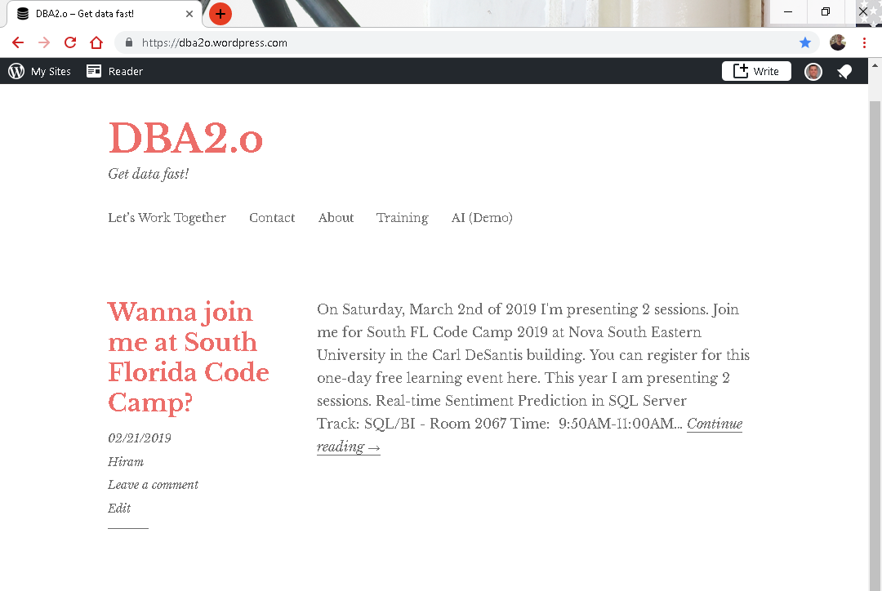

Slide 5
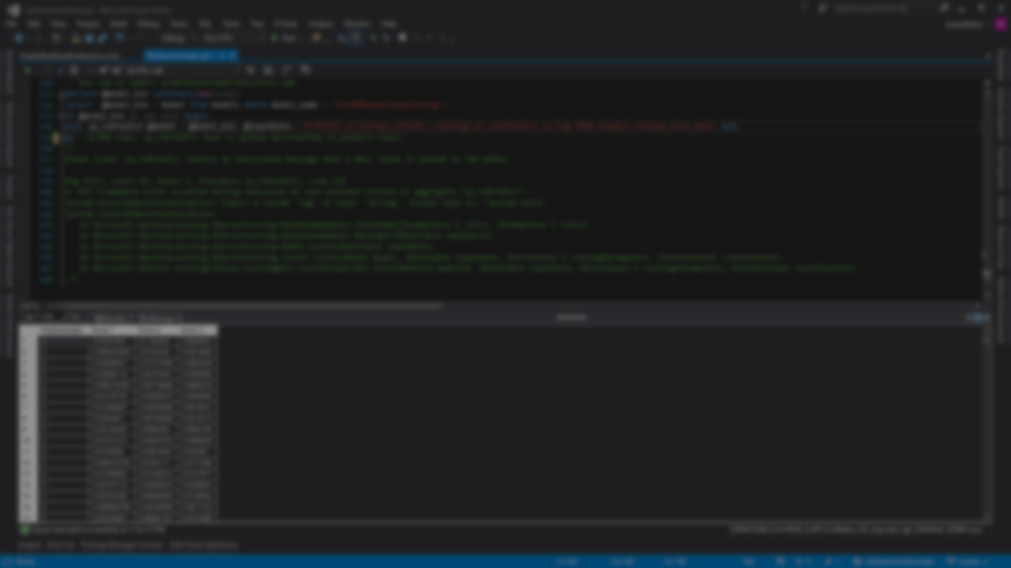
Session evaluations
This is the link:
bit.ly/pbi18
Your feedback is very important.
Submit your feedback by the end of this presentation.

Slide 6



BIO
Father
Principal DB Architect
Power BI since 2016
SQL Server since 1999
Developer since 1995
USCG Auxiliary Staff Officer
Microsoft Certified Professional
Power BI Certified
Hiram Fleitas
Owner – Fleitas Arts, LLC
FUN
Construction & Family
/HiramFleitas
/hfleitas
@HiramFleitas
hiram@fleitasarts.com
HiramFleitas
fleitasarts.com

Slide 7
Schedule (times are approximate and will be fluid with the class)
Morning
09:00 AM – 11:45 AM – Advanced Data Modeling
Afternoon
11:45 AM – 1:00 PM – Power BI Administration
Notes:
Key message: in this workshop we will cover the breath of Power BI capabilities.
After analyzing and visualizing the dataset provided in the workshop, you will use the these skills to get started on your own data.

Slide 8
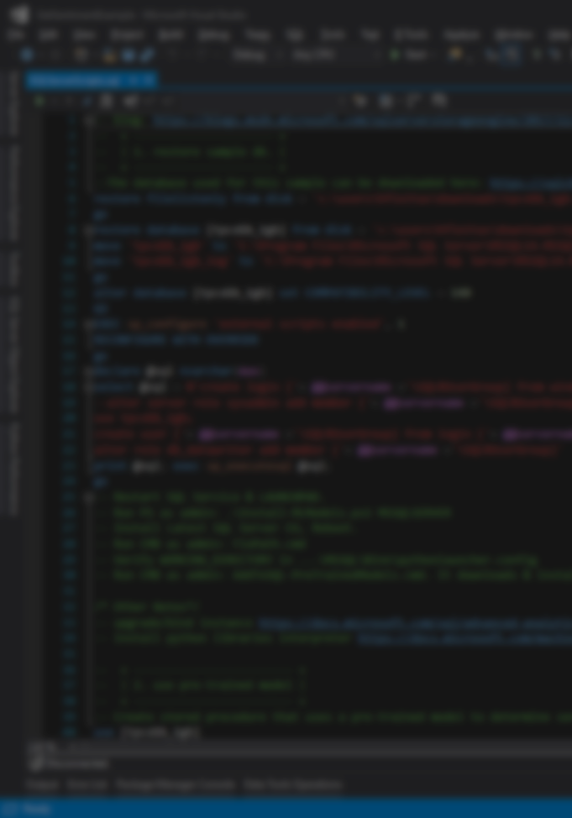
Agenda
Filtering (20min)
Cross-Filtering and Time Intelligence (20min)
Many to Many with DAX (15min)
Creating a Bridge Table (20min)
Role Playing Tables with DAX (20min)
Role Playing Tables without DAX (20min)
Mismatched Granularities (30min)
Weighted Allocation (20min)
Data Refresh Overview (20min)
Scheduling Data Refresh (20min)
Implementing Row Level Security (20min)
Implementing Dynamic Security (15min)

Slide 9
Agenda
Power BI Embedded (20min)
Key Influencers (20min)
Automated-ML (20min)
New Features Announcements (30min)
Q&A + Resources (30min)

Slide 10

Advanced Data Modeling
Filtering
Notes:
In previous courses we show you how to build a relationship in the data model, but we really don’t go into detail why we build the relationship the way that we do and some of the available options. So we’re going to talk about Filtering now and we’re going to get into Cross-Filtering as well. Because Cross-Filtering is going to give us support for Many to Many relationships.

Slide 11
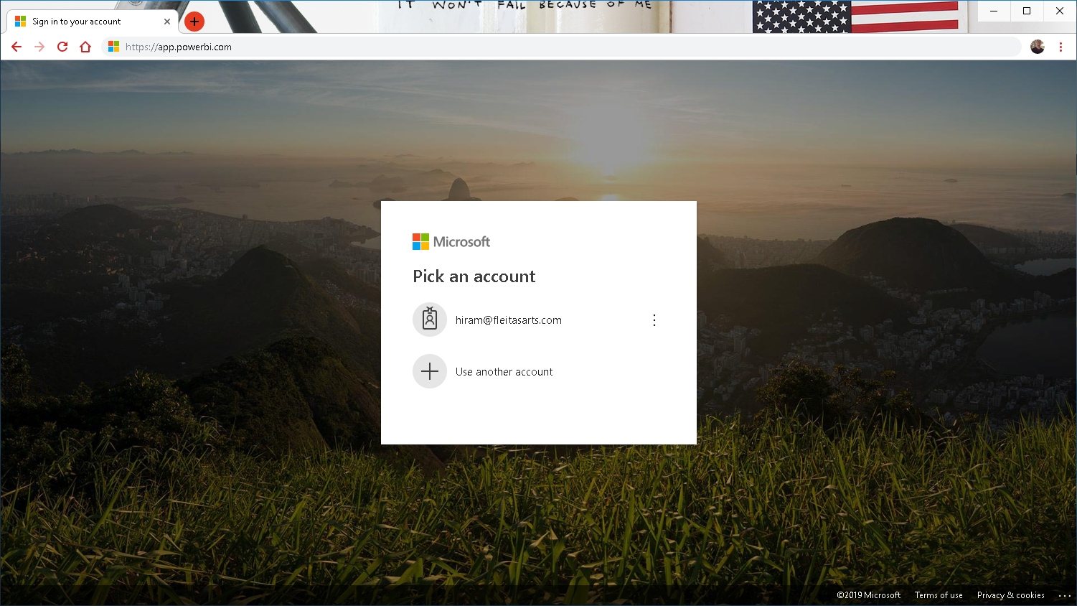
Notes:
Login to https://app.powerbi.com impersonating an end user. Launch DIAD app

Slide 12
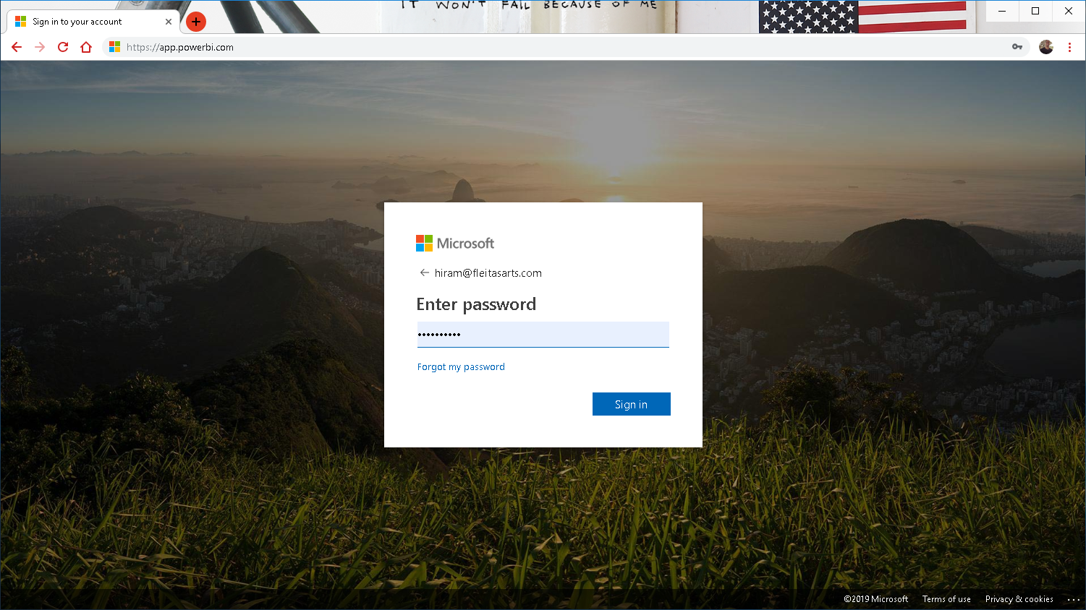
Notes:
Login to https://app.powerbi.com impersonating an end user. Launch DIAD app

Slide 13
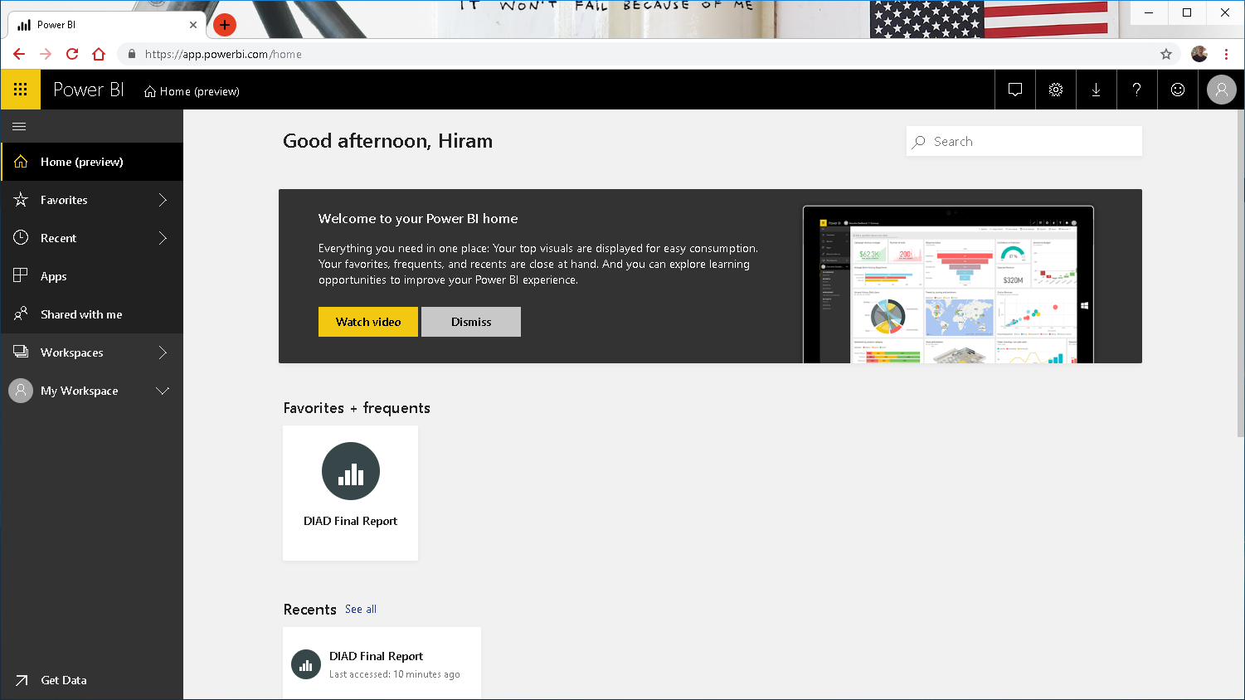
Notes:
Navigate to Market Share page of DIAD Final Report

Slide 14
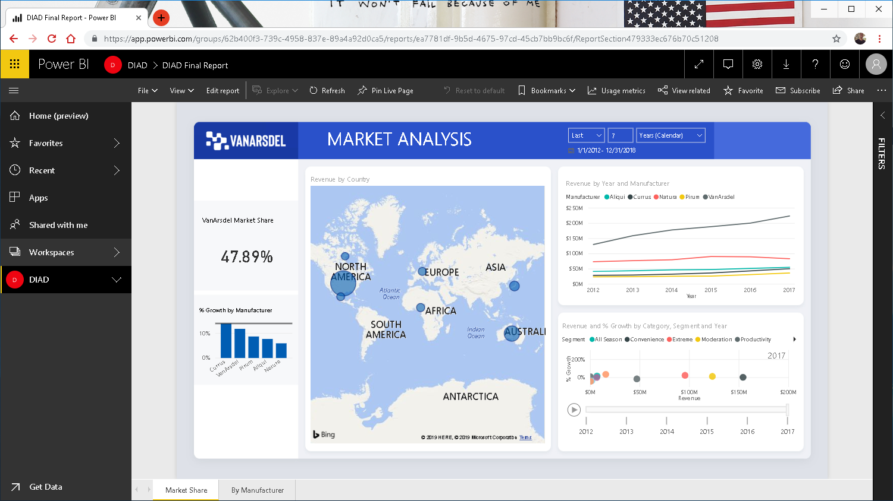
Notes:
Using the line chart talk about the fact that VanArsdel has a large market share compared to other manufacturers. Also notice that sales are increasing YoY.

Slide 15
Notes:
Using the line chart talk about the fact that VanArsdel has a large market share compared to other manufacturers. Also notice that sales are increasing YoY.

Slide 16

Notes:
Using the line chart talk about the fact that VanArsdel has a large market share compared to other manufacturers. Also notice that sales are increasing YoY.

Slide 17

Notes:
Notice USA has the maximum sales. Select USA bubble in the map visual

Slide 18
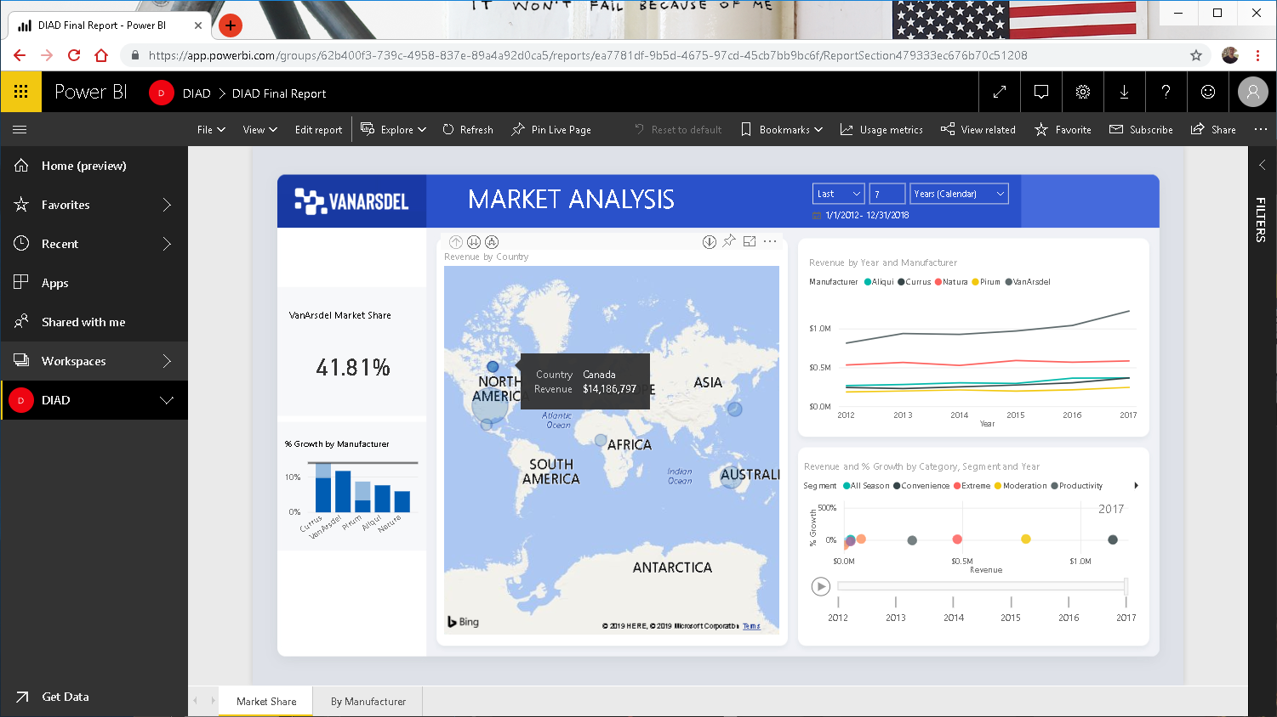
Notes:
Now select other countries like Canada, Japan and notice VanArsdel Market Share

Slide 19
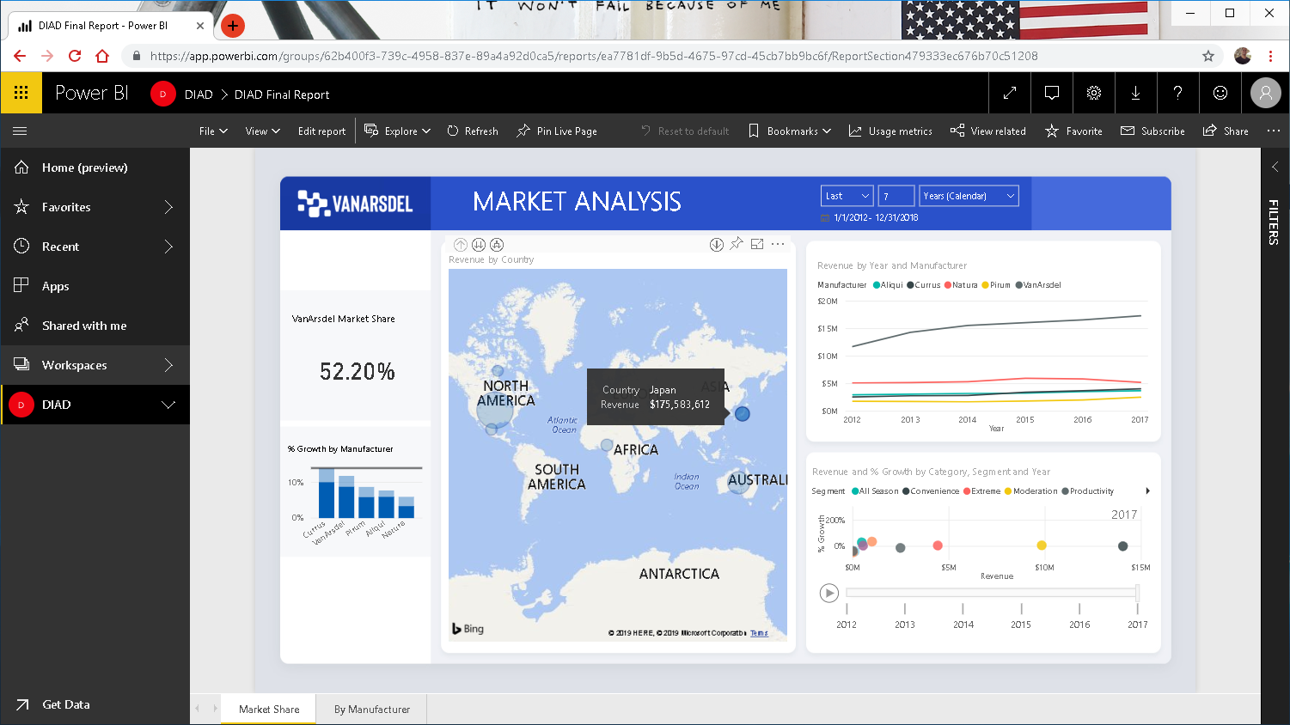
Notes:
Now select other countries like Canada, Japan and notice VanArsdel Market Share

Slide 20
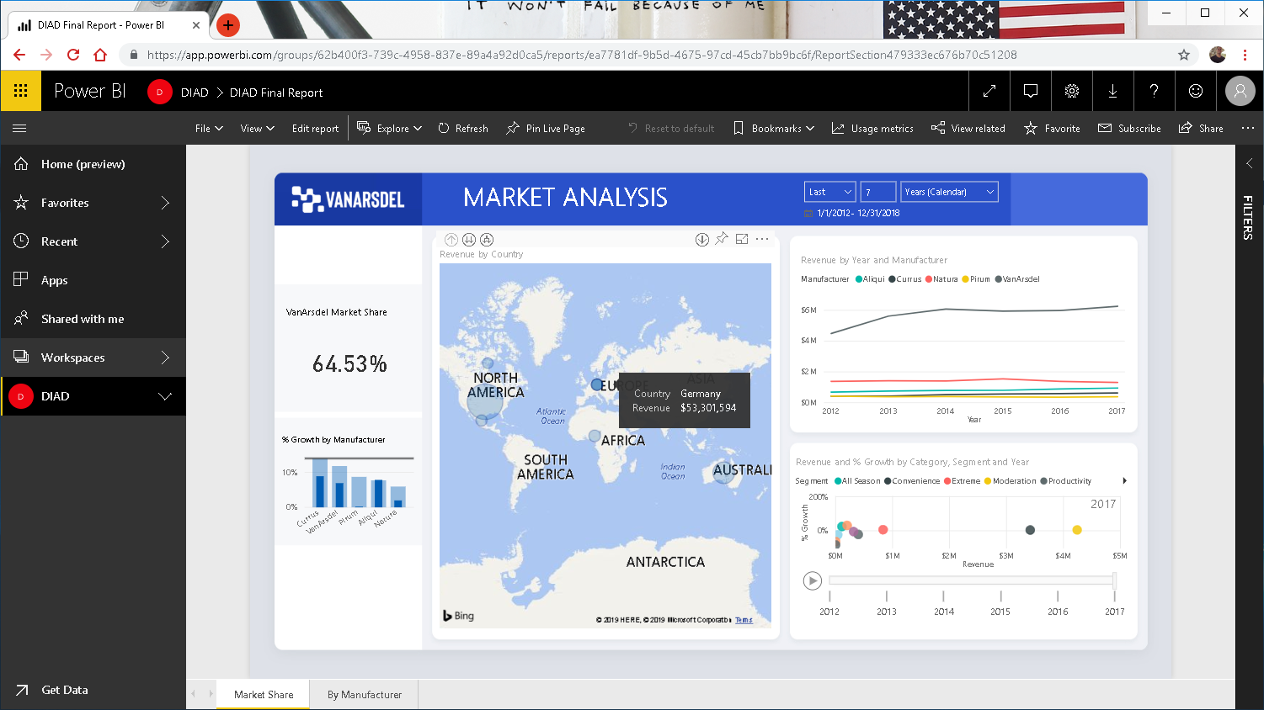
Notes:
Select Germany and notice VanArsdel Market Share is 64%. Also notice in the line chart the growth is steady

Slide 21
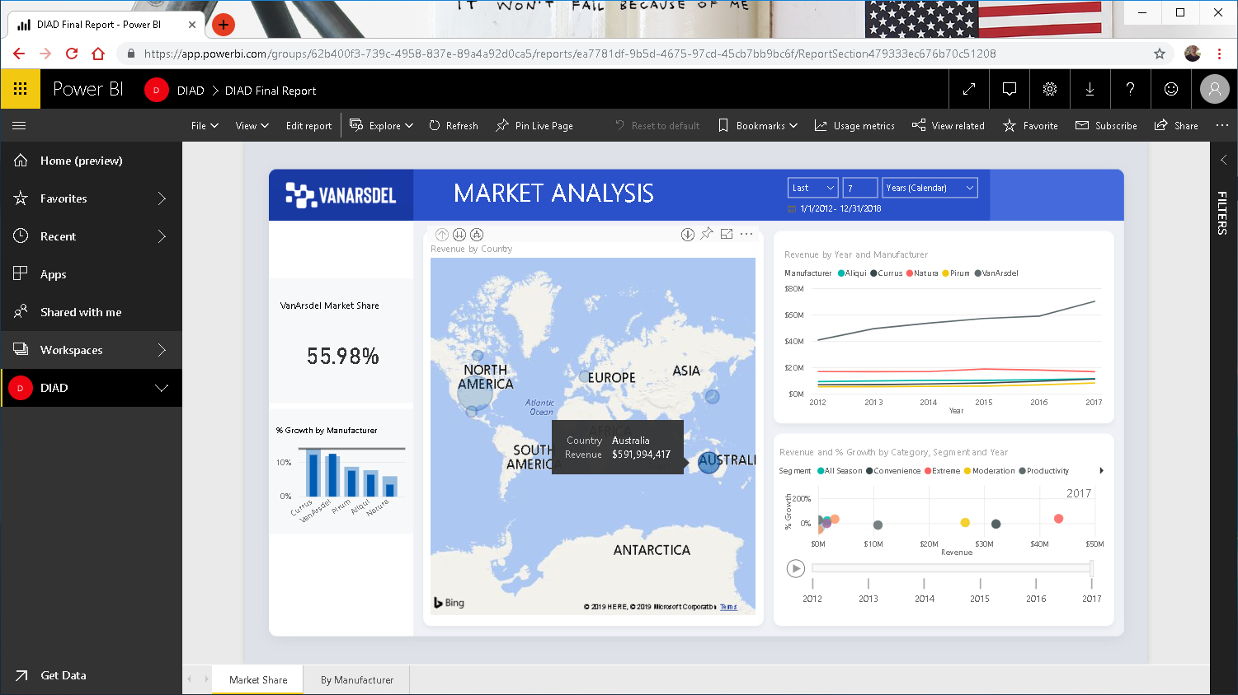
Notes:
Select Australia bubble and notice VanArsdel Market Share is 55% and in the line chart notice there is a big spike in 2017

Slide 22
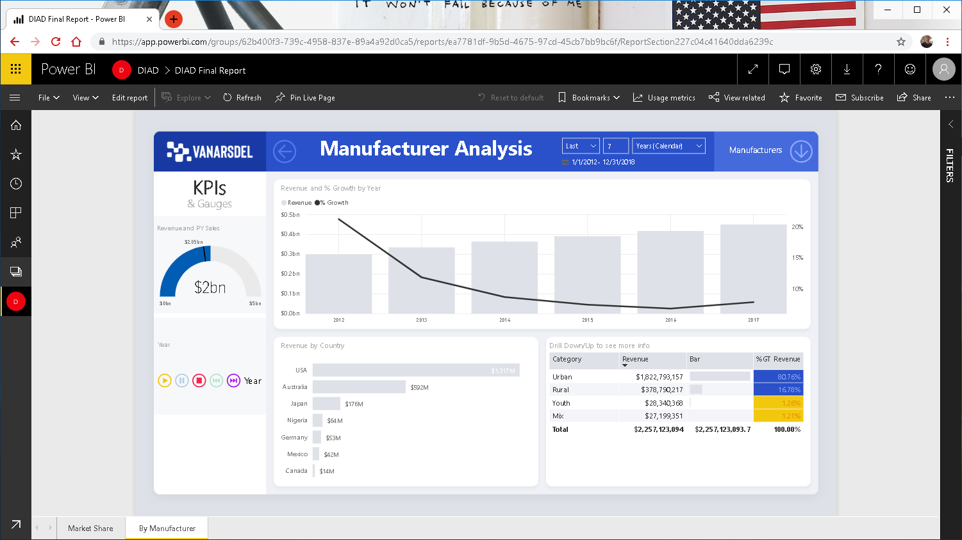

Notes:
Let’s investigate further, navigate to By Manufacturer page

Slide 23
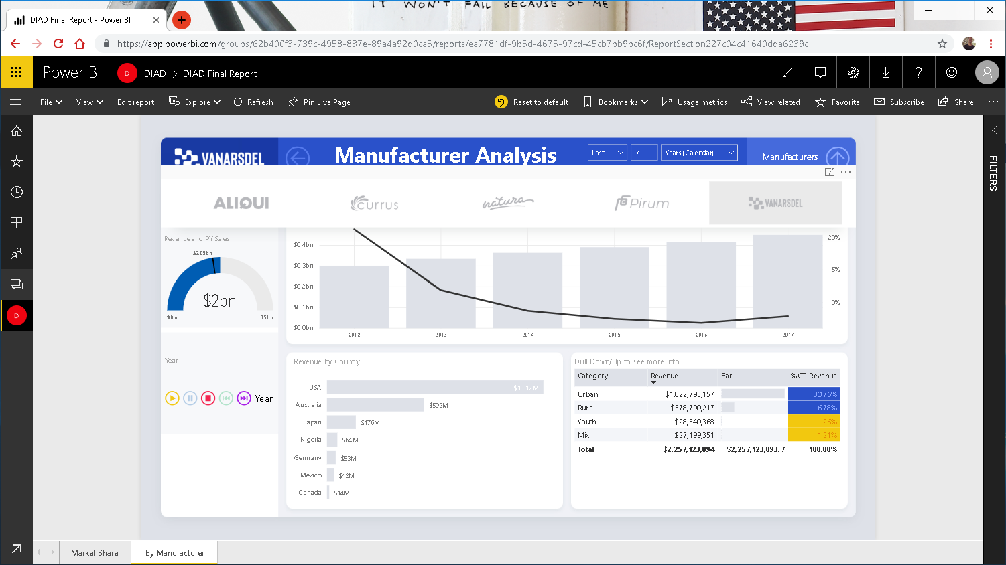
Notes:
Using Manufacturer slicer filter down to VanArsdel

Slide 24
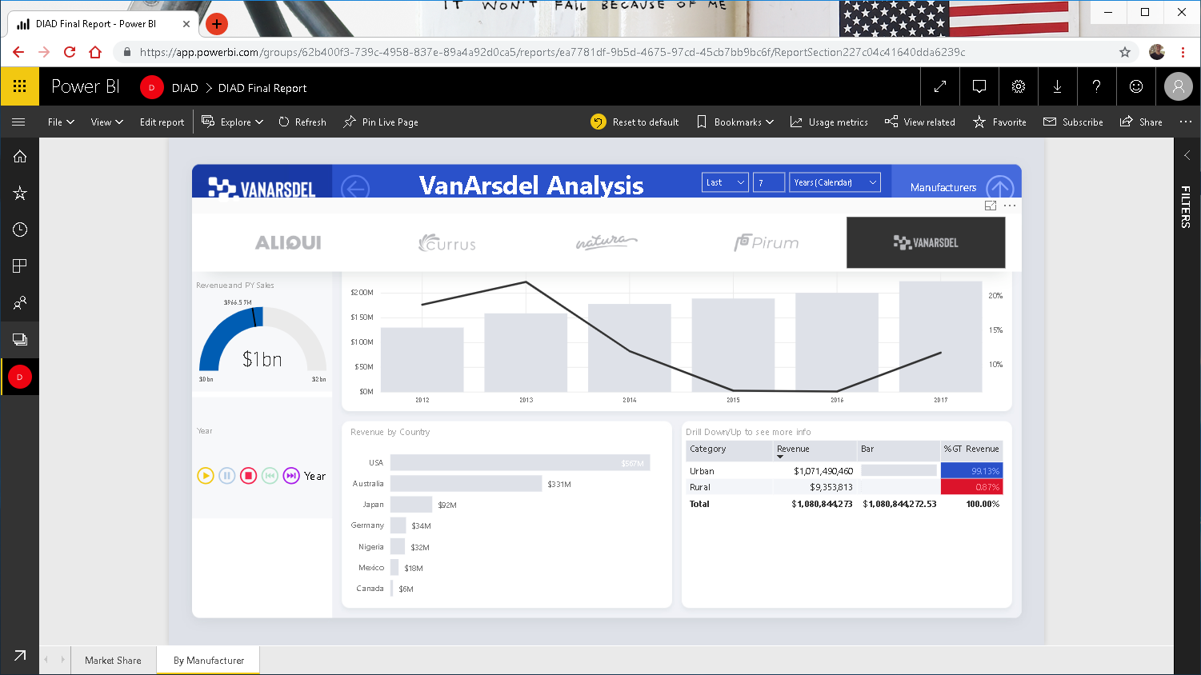
Notes:
Using Manufacturer slicer filter down to VanArsdel

Slide 25
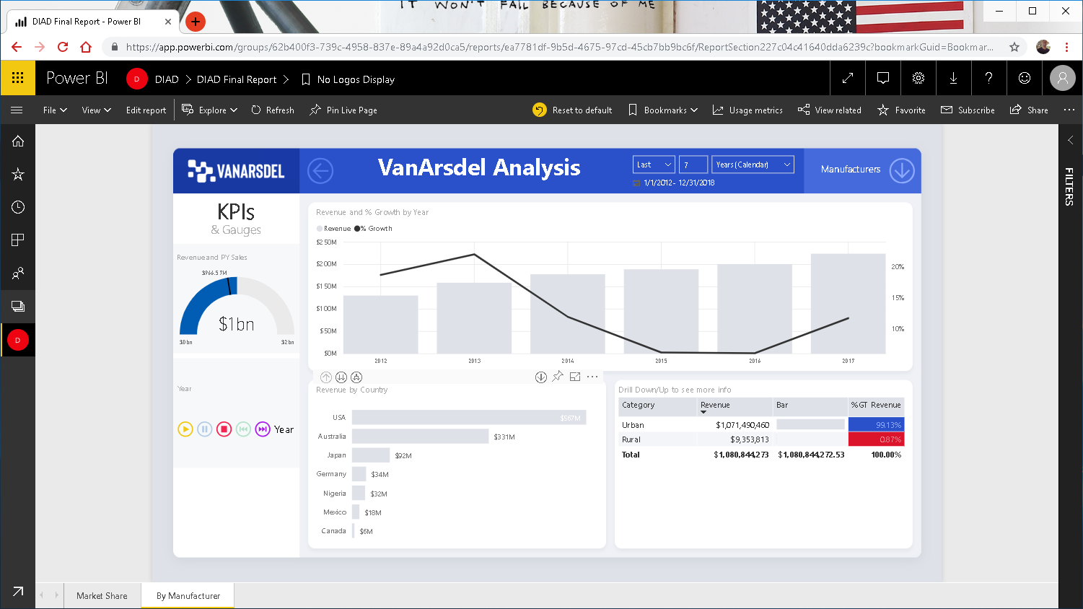

Slide 26
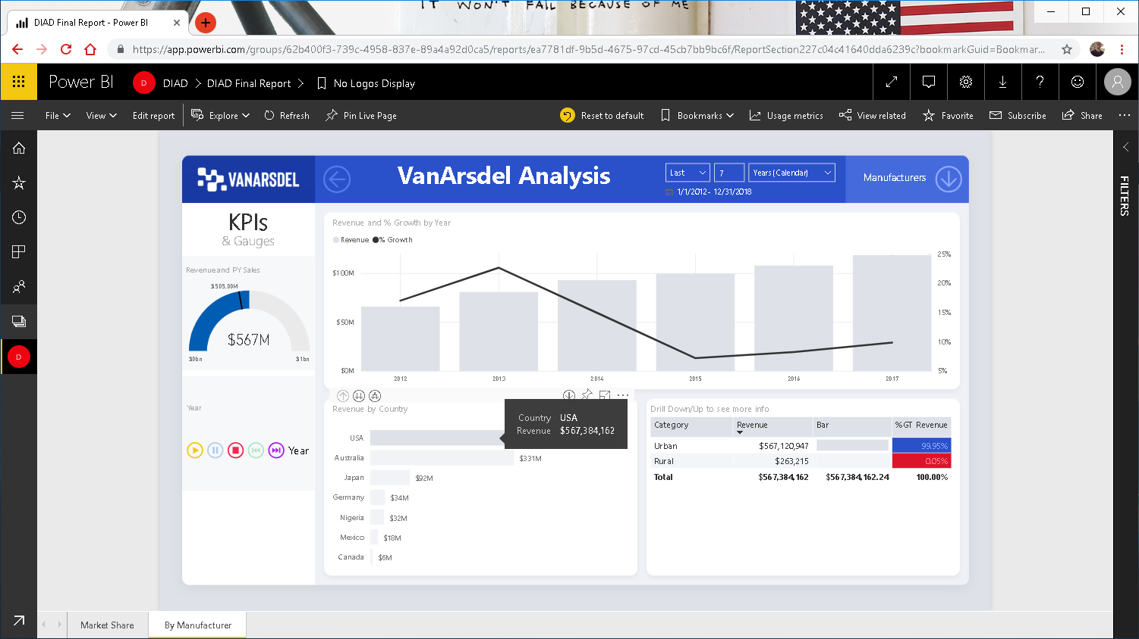
Notes:
Notice sales has increased marginally in 2017 and Urban category is 99% of the revenue

Slide 27
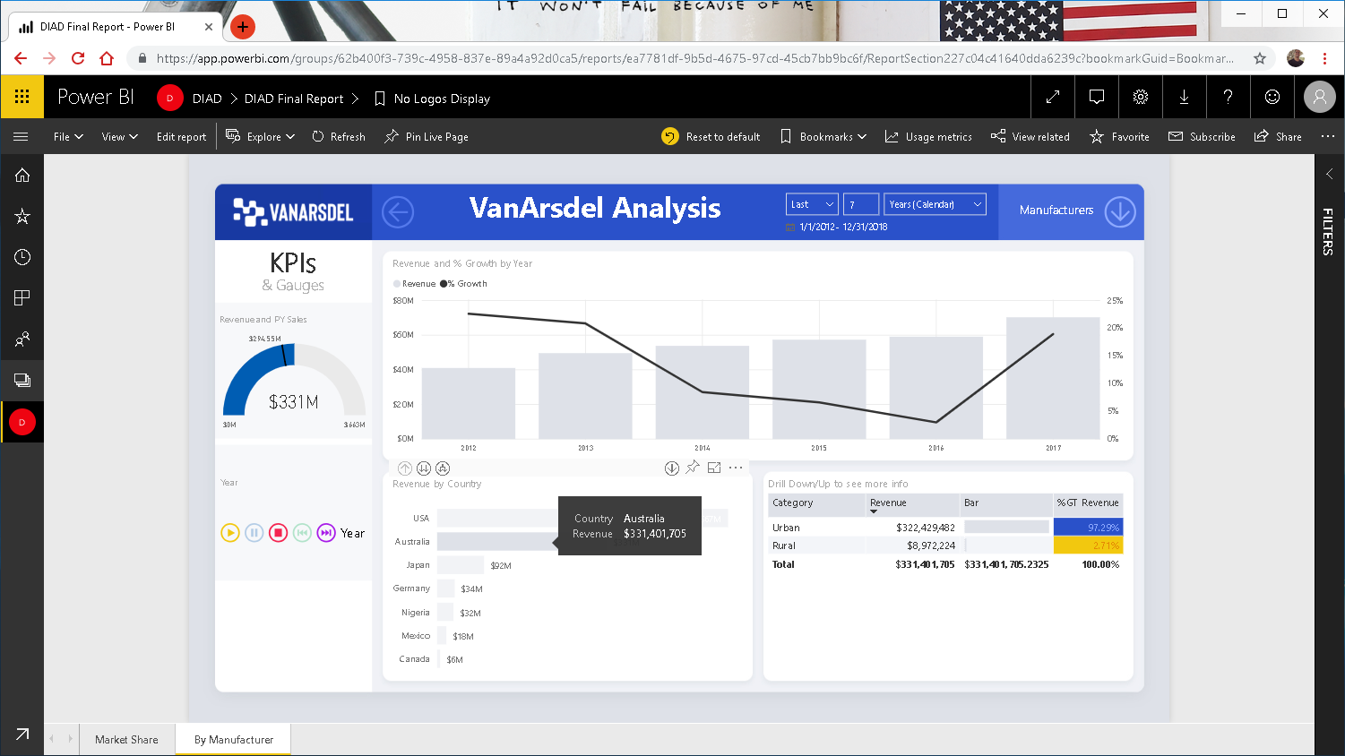
Notes:
Select Australia in the Revenue by Country visual.
Notice sales has spiked in 2017 and Urban category is 97% of the revenue.

Slide 28
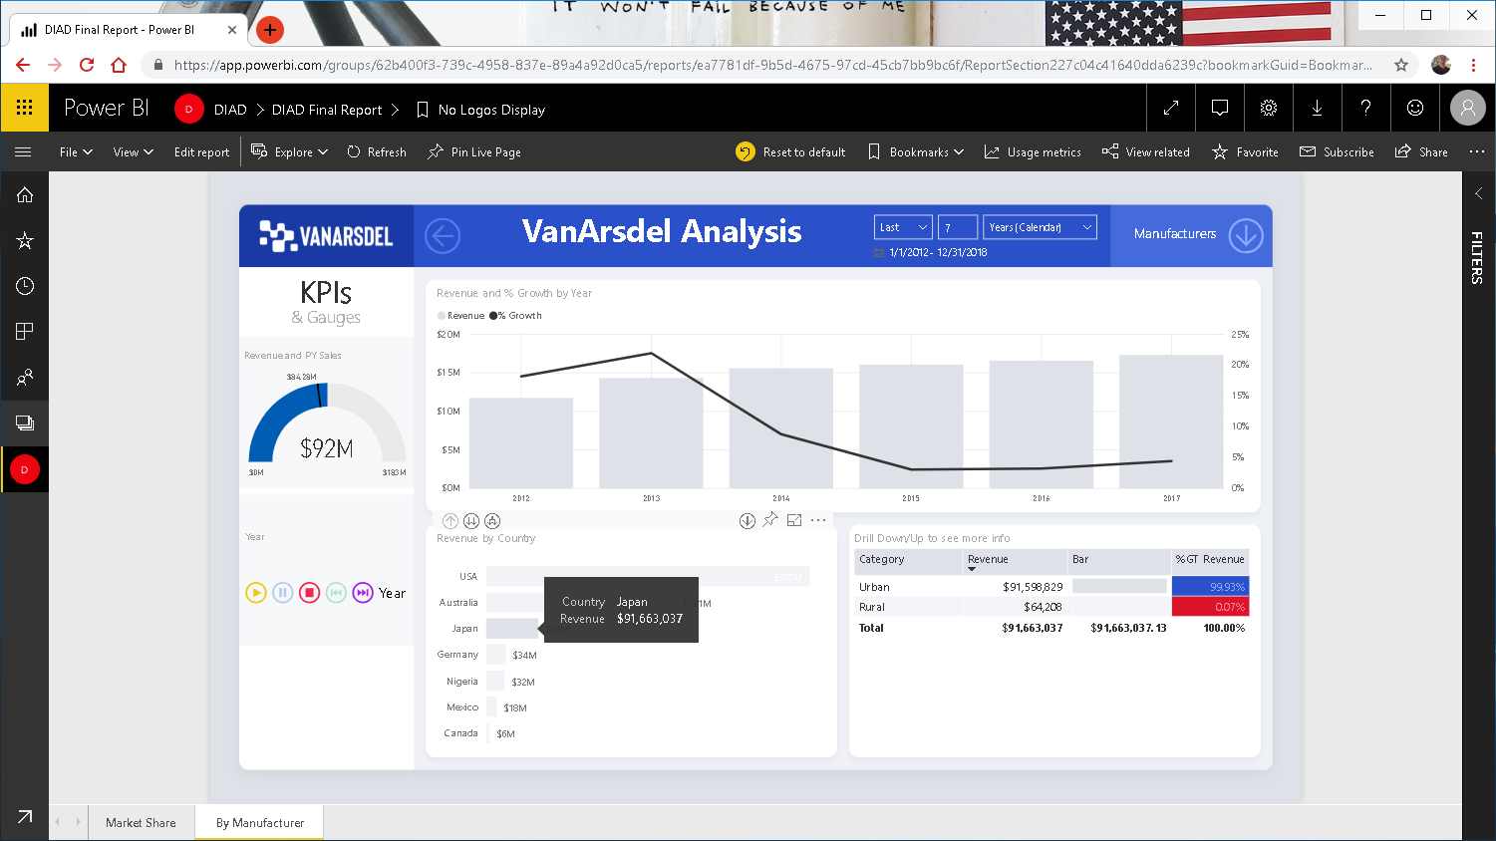
Notes:
Similarly select Japan and again Urban category in 99%

Slide 29
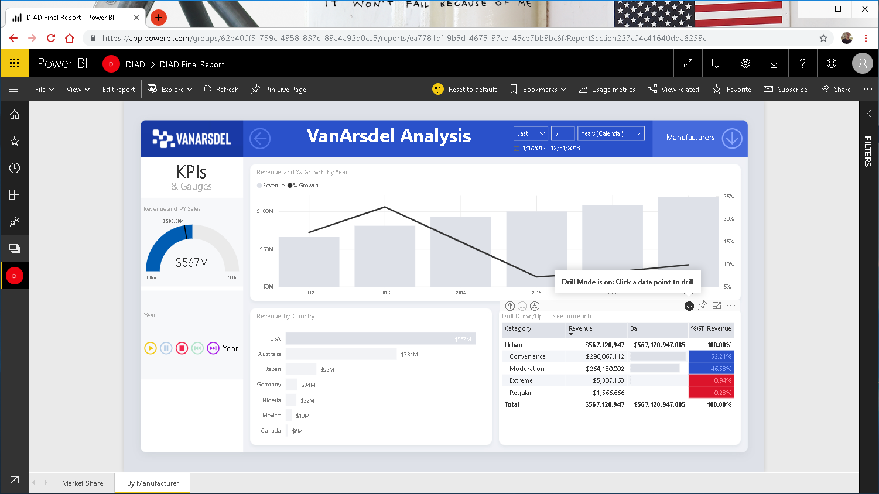
Notes:
Let’s drill down Urban category and investigate further
Select USA in the Revenue by Country visual
Notice Convenience is the biggest Segment followed by Moderation and Extreme segments

Slide 30

Notes:
Select Japan in the Revenue by Country visual
Notice Convenience is the biggest Segment followed by Moderation and Extreme segments

Slide 31
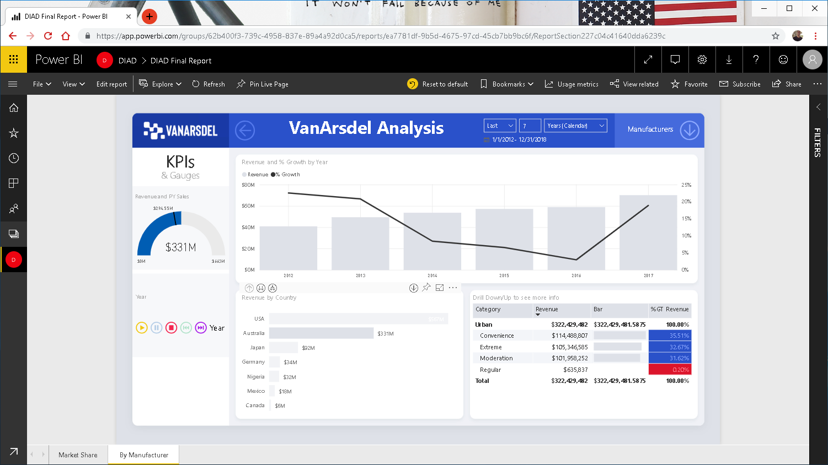
Notes:
Select Australia in the Revenue by Country visual
Notice sales in Convenience, Moderation and Extreme segments are both in mid 30%.
Let’s investigate this further. Sales in Australia is out of the norm.

Slide 32
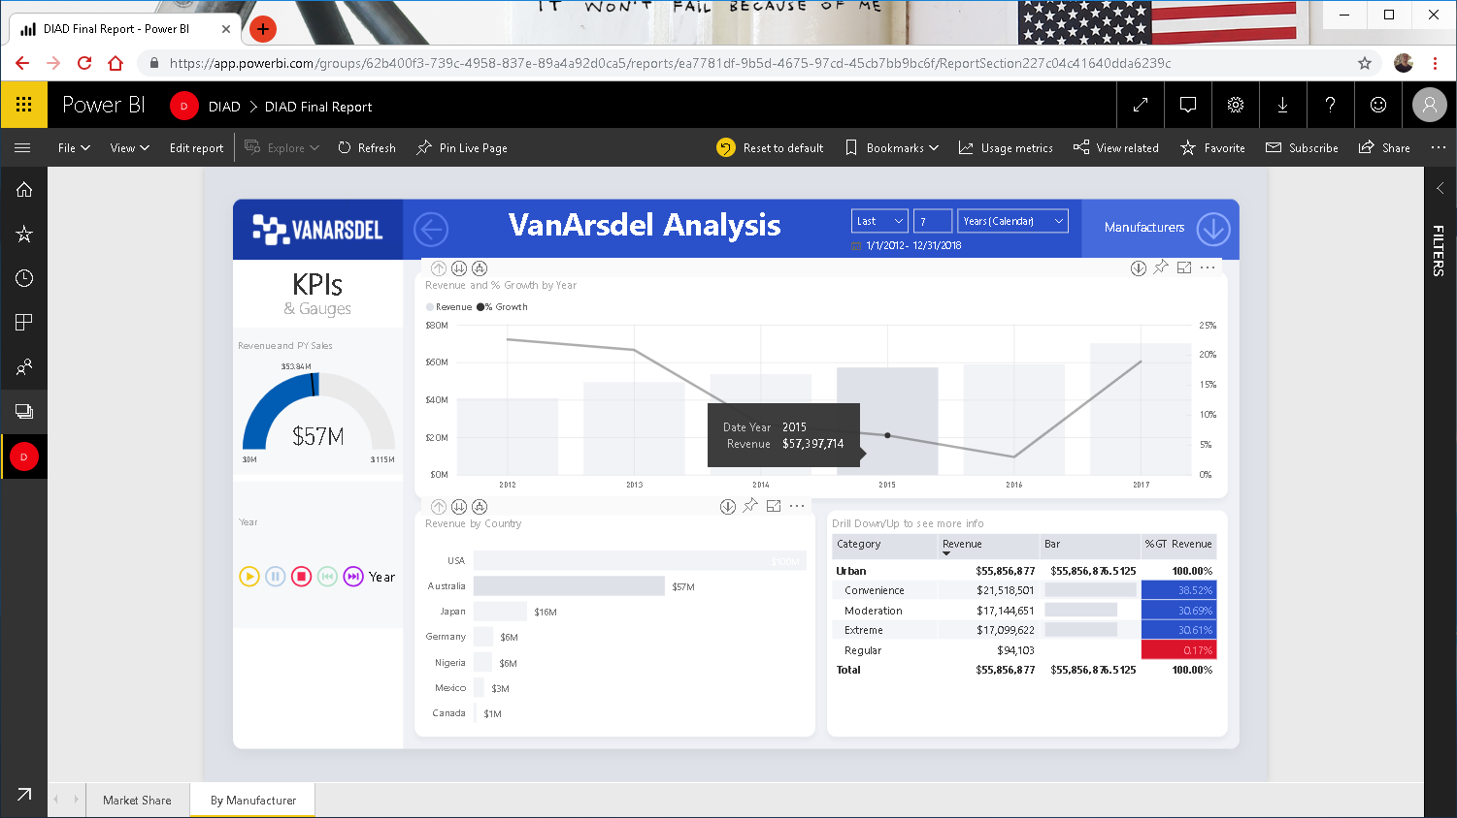
Notes:
Make sure Australia is selected in Revenue by Country visual
Press & hold the CTRL key and click 2015 in the Revenue and %Growth by Year visual
No major change is sales by Product segment

Slide 33
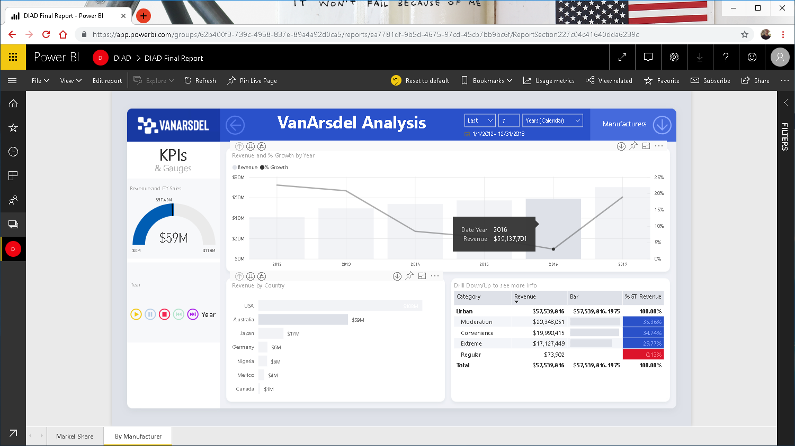
Notes:
CTRL click 2015 to deselect and click 2016
No major change is sales by Product segment

Slide 34
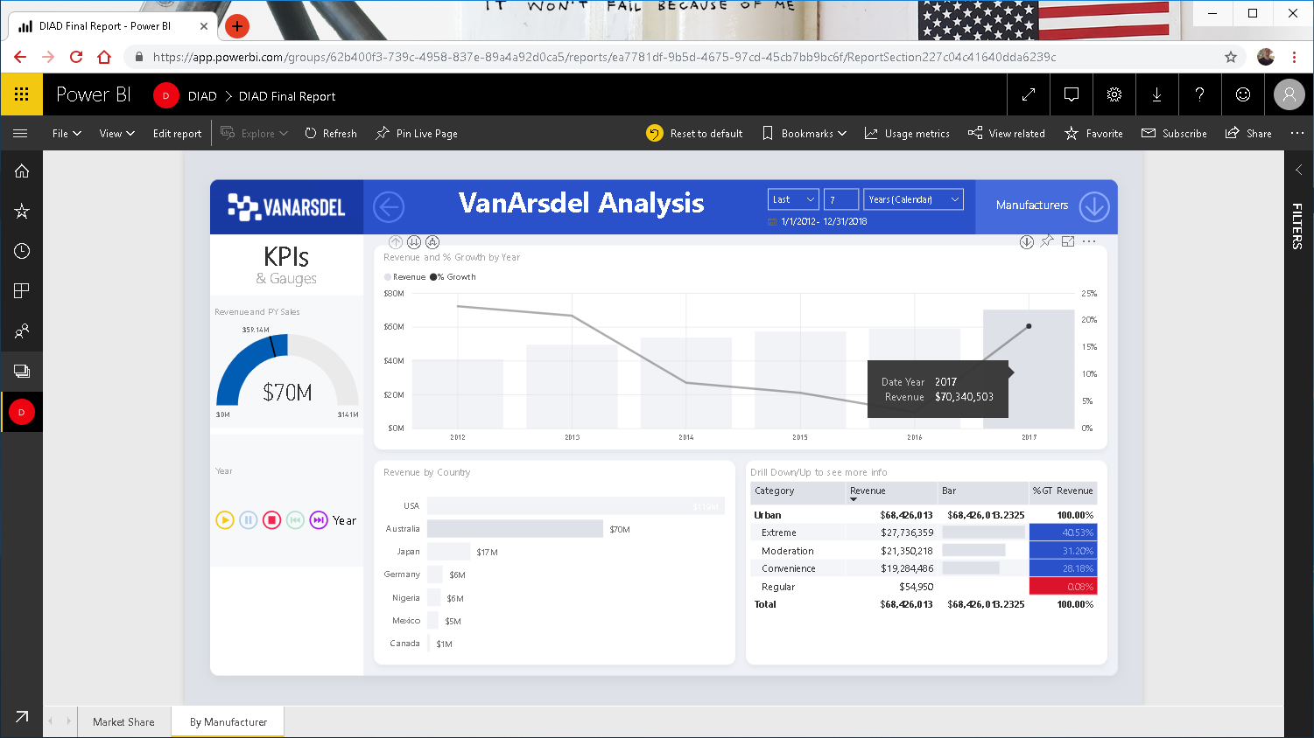
Notes:
CTRL uncheck 2016 and select 2017
Notice there is a spike is sales of Extreme in 2017.

Slide 35
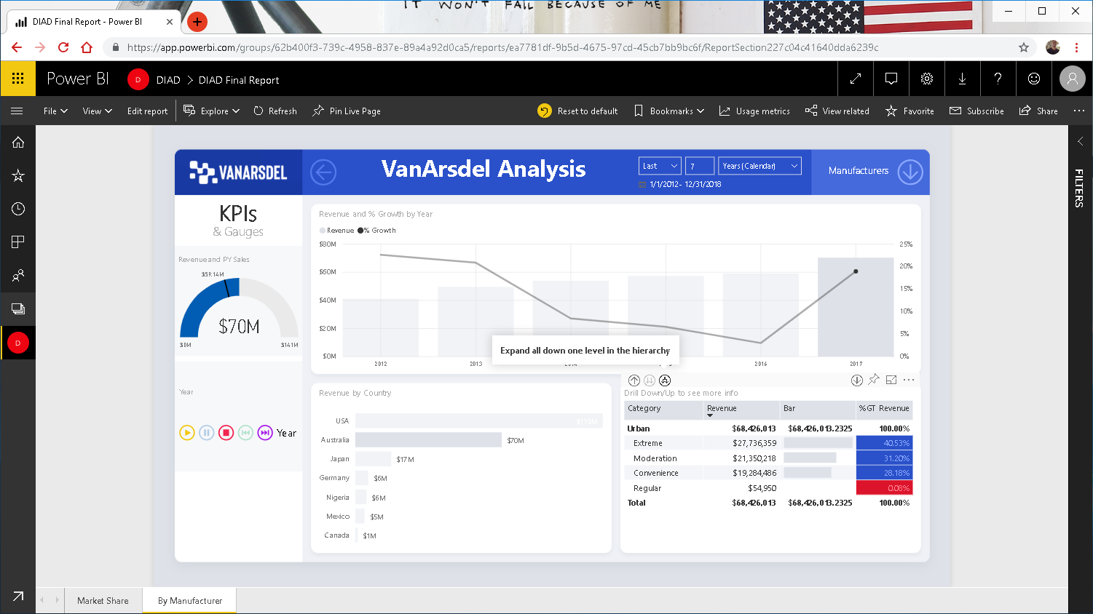
Notes:
Let’s Expand All Down one level in the hierarchy to Product level and check if there is anything interesting happening

Slide 36
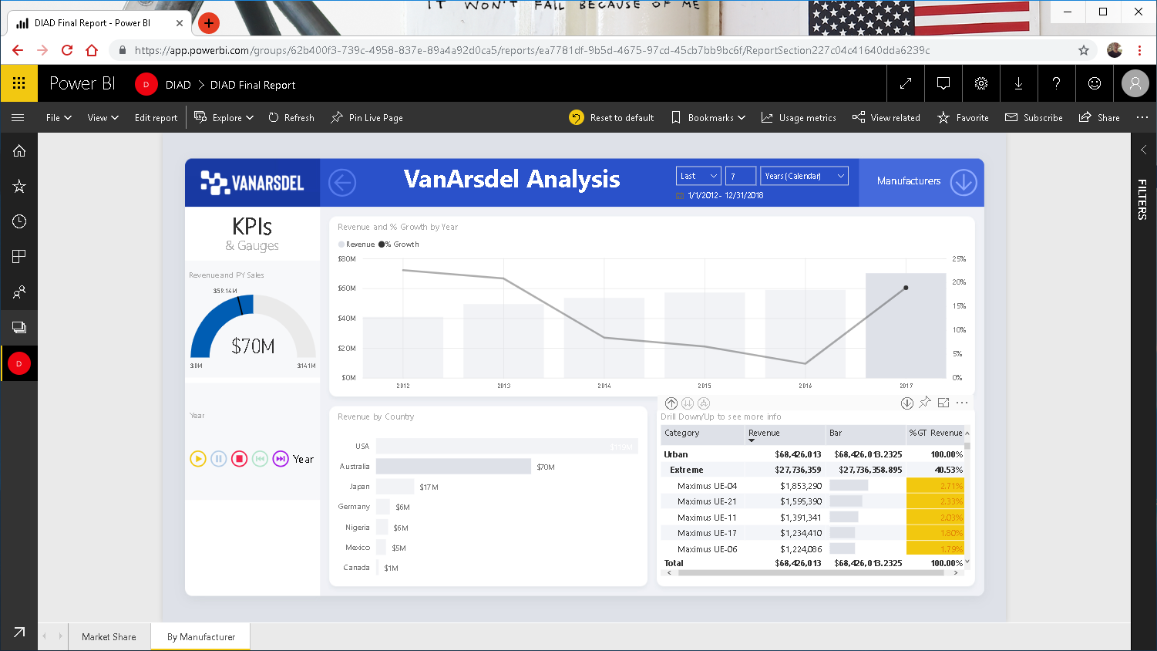
Notes:
See Extreme segment in the matrix. Now we see the top Products for Category Urban, Extreme in Australia.
With Australia selected in Revenue by Country visual CTRL click Maximus UE-04.

Slide 37
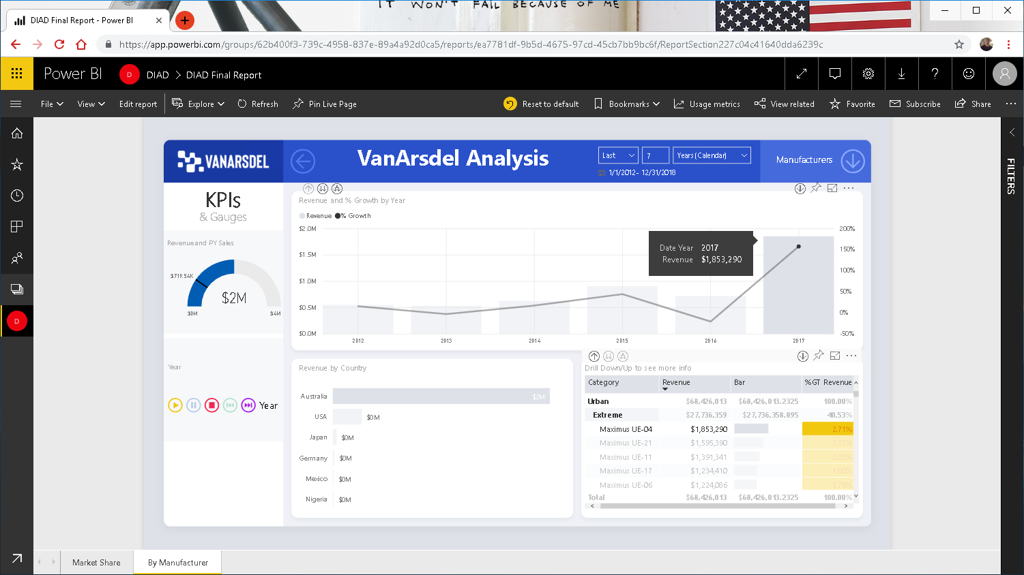
Notes:
CTRL click Maximus UE-04. Notice the spike in 2017. Just like this there are spikes for all the Top 5 products we see in descending order by Revenue of the product matrix.
Notice from previous years the amount of revenue that’s been sold for this one Product in Australia.
Now, let’s look at a month level.

Slide 38
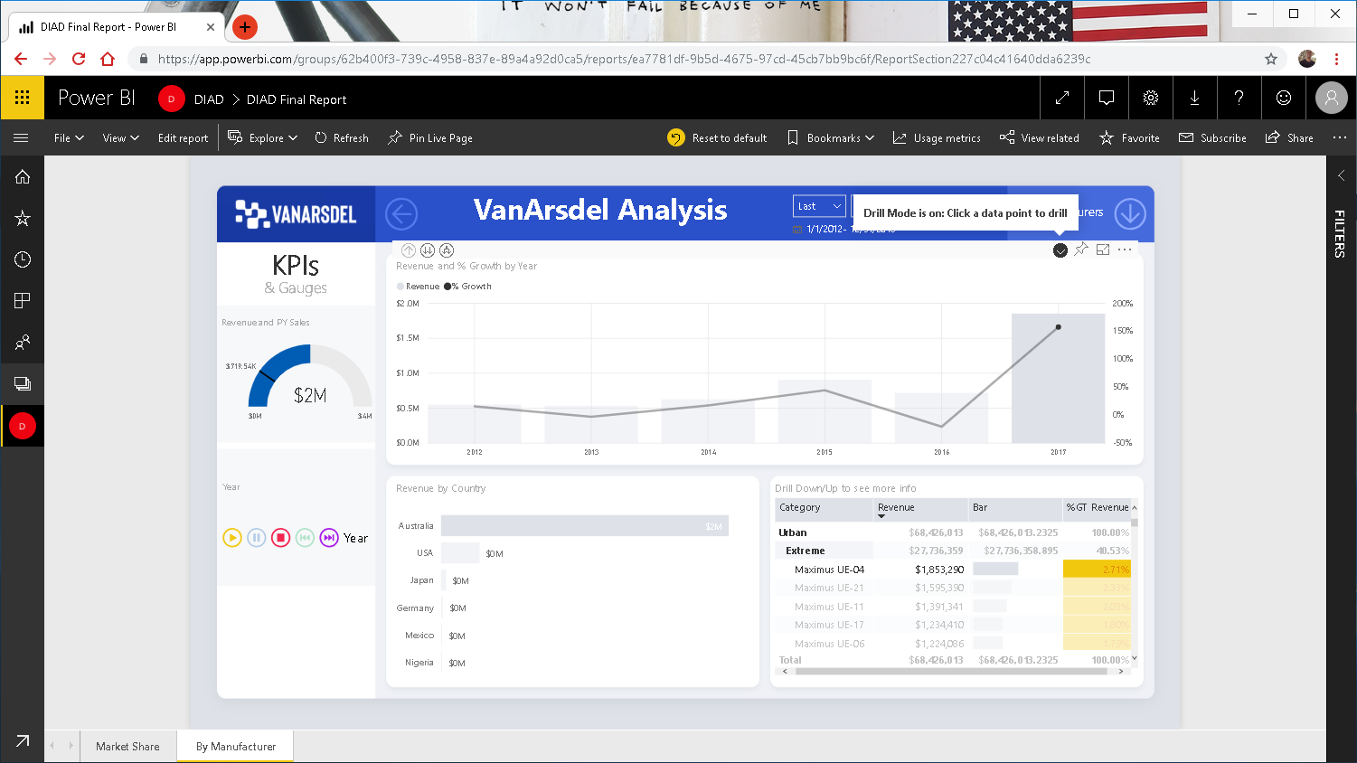
Notes:
Make sure Australia is selected in Revenue by Country visual
Let’s drill down into 2017 to the month level and investigate.

Slide 39
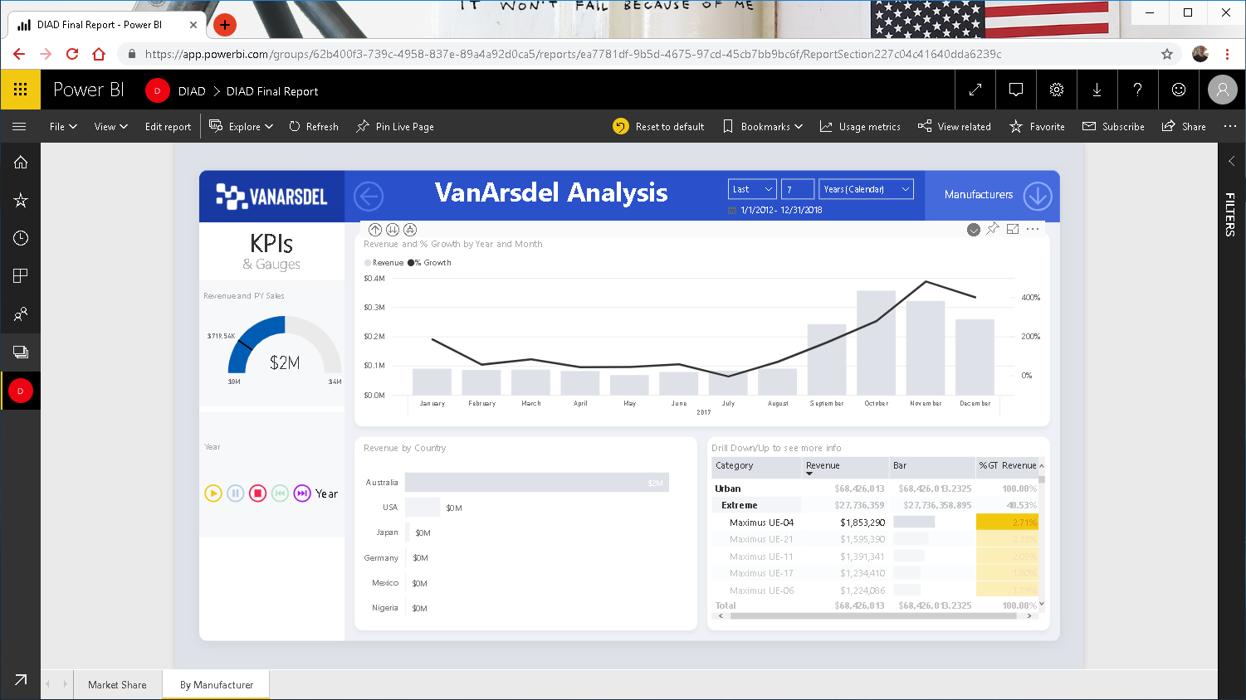
Notes:
Notice the spike is in the last 4 months of 2017. That’s where the action is.
Similar situation for Maximus UE-21.
This is good, let’s drill down to day level to check if spikes was on particular days .

Slide 40
Notes:
CTRL click September of 2017 to drill down to the next level.

Slide 41
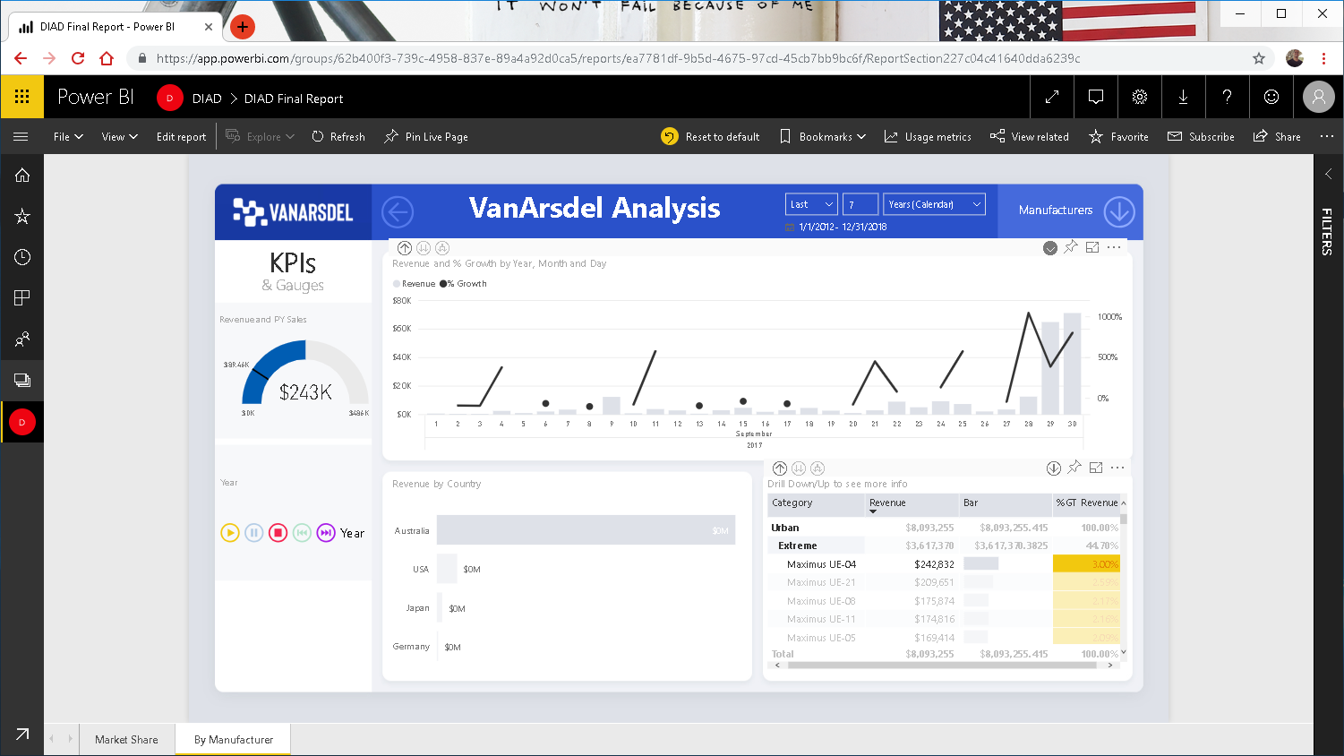
Notes:
Notice the spike at the end of September.
Holding CTRL key, deselect Maximus UE-04 to see all products.

Slide 42
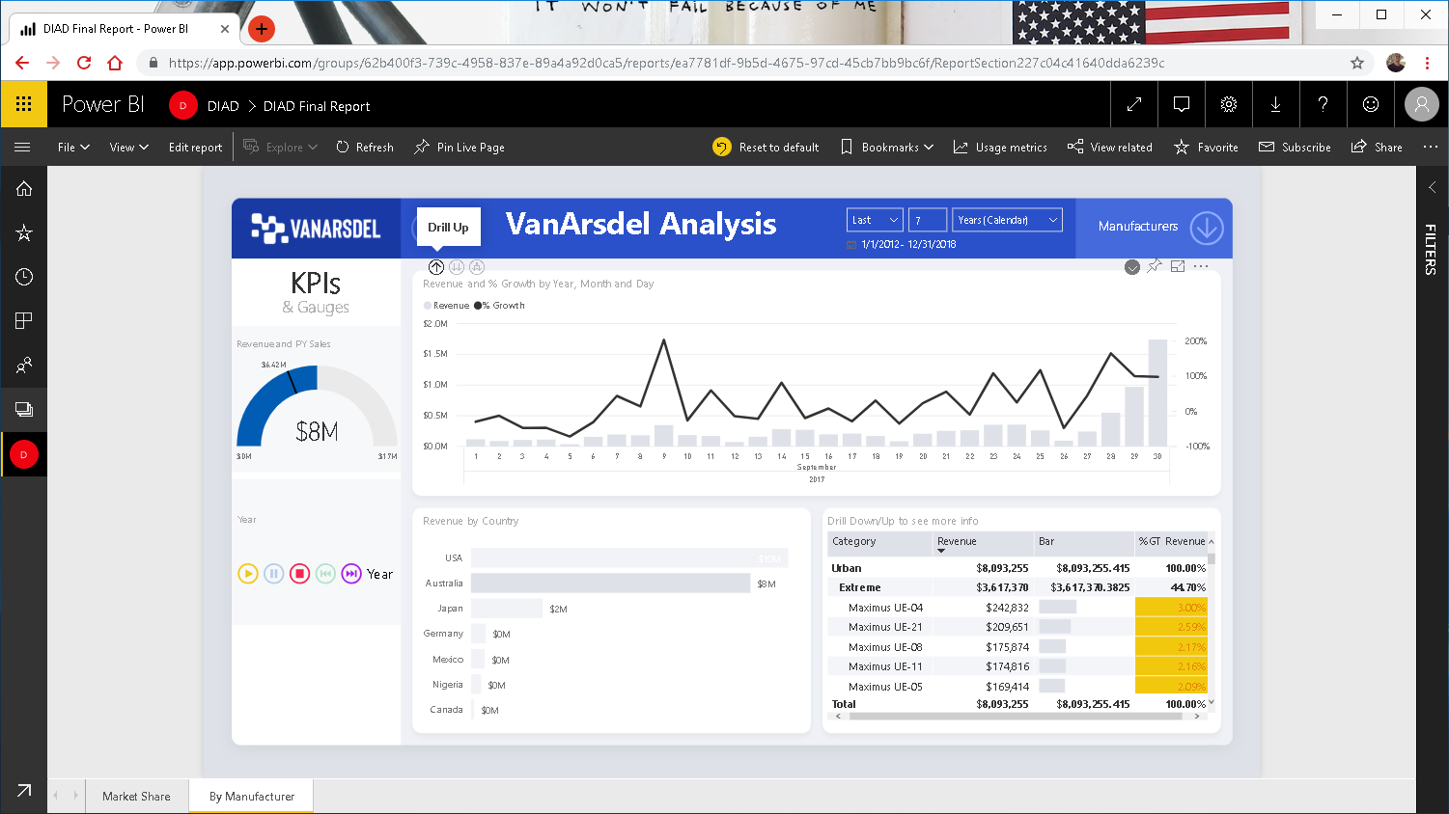
Notes:
Notice the spike at the end of September and lets drill-up to Months to investigate the beginning of October.
Holding CTRL key, deselect Maximus UE-04 to see all products.

Slide 43
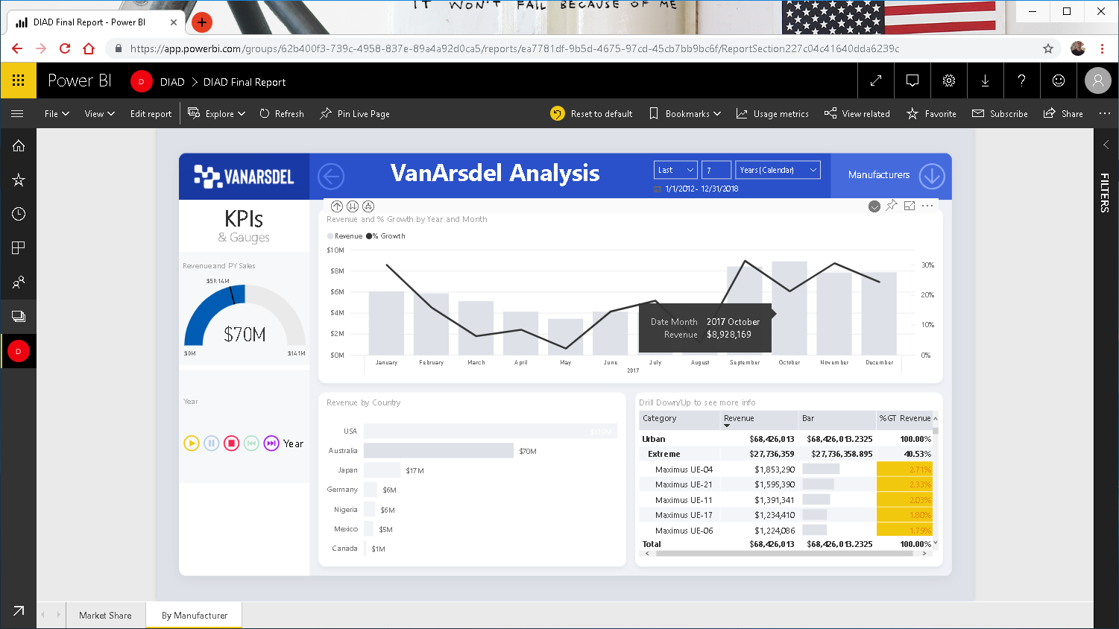
Notes:
Hold CTRL and click October of 2017 to drill-down again.

Slide 44
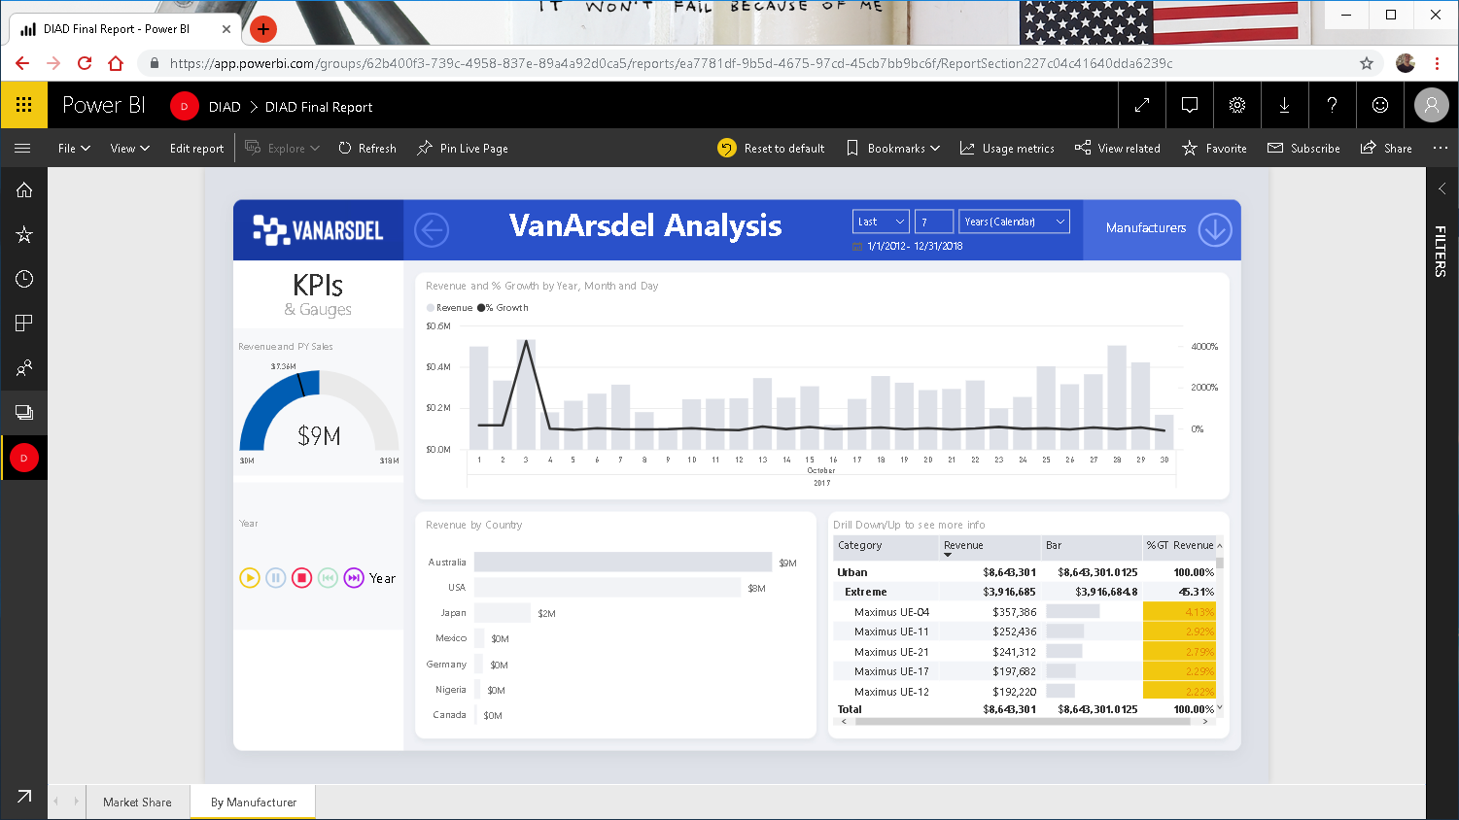
Notes:
Notice there is a spike the first few days and then it holds steady.
So something clearly happened end of September and early October that caused the spike.

Slide 45
DEMO 2
Power BI Bookmarks

Slide 46
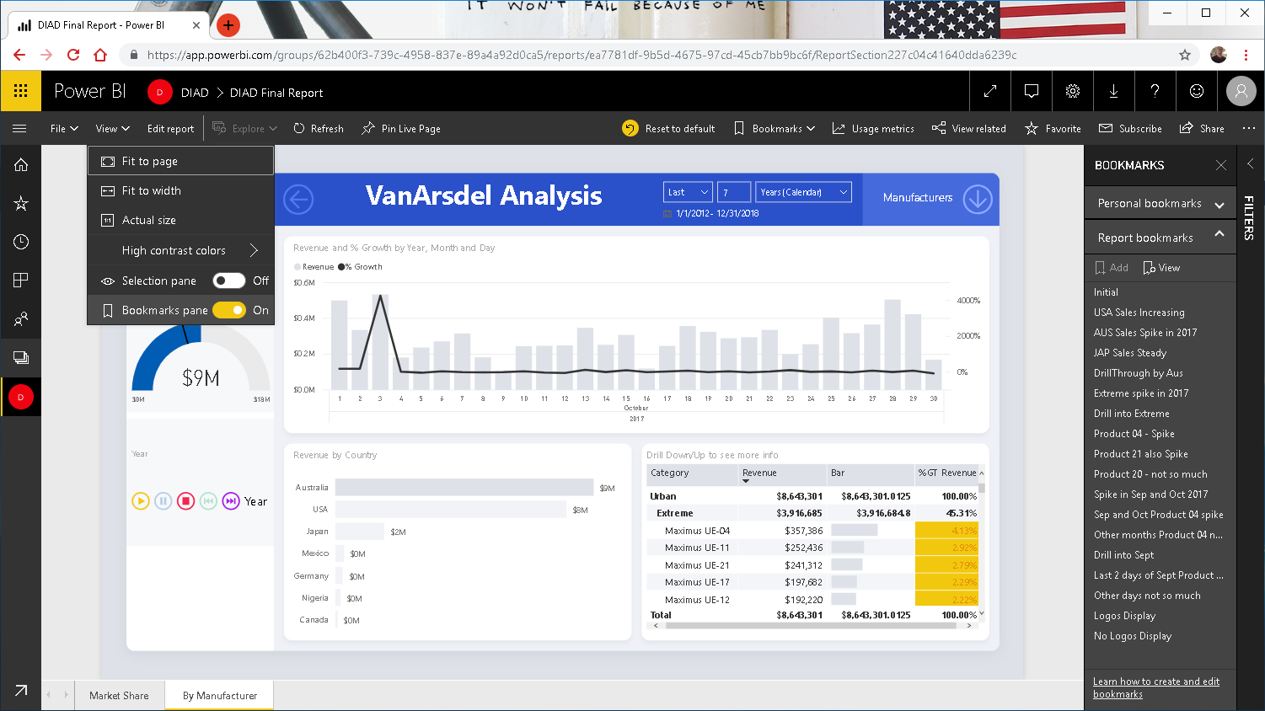
Notes:
From the menu, select View. Enable Bookmarks Pane
Notice Bookmarks has been created for the story we just discovered.
This is a great feature to use for presentations, highlight insights or tell a story.

Slide 47
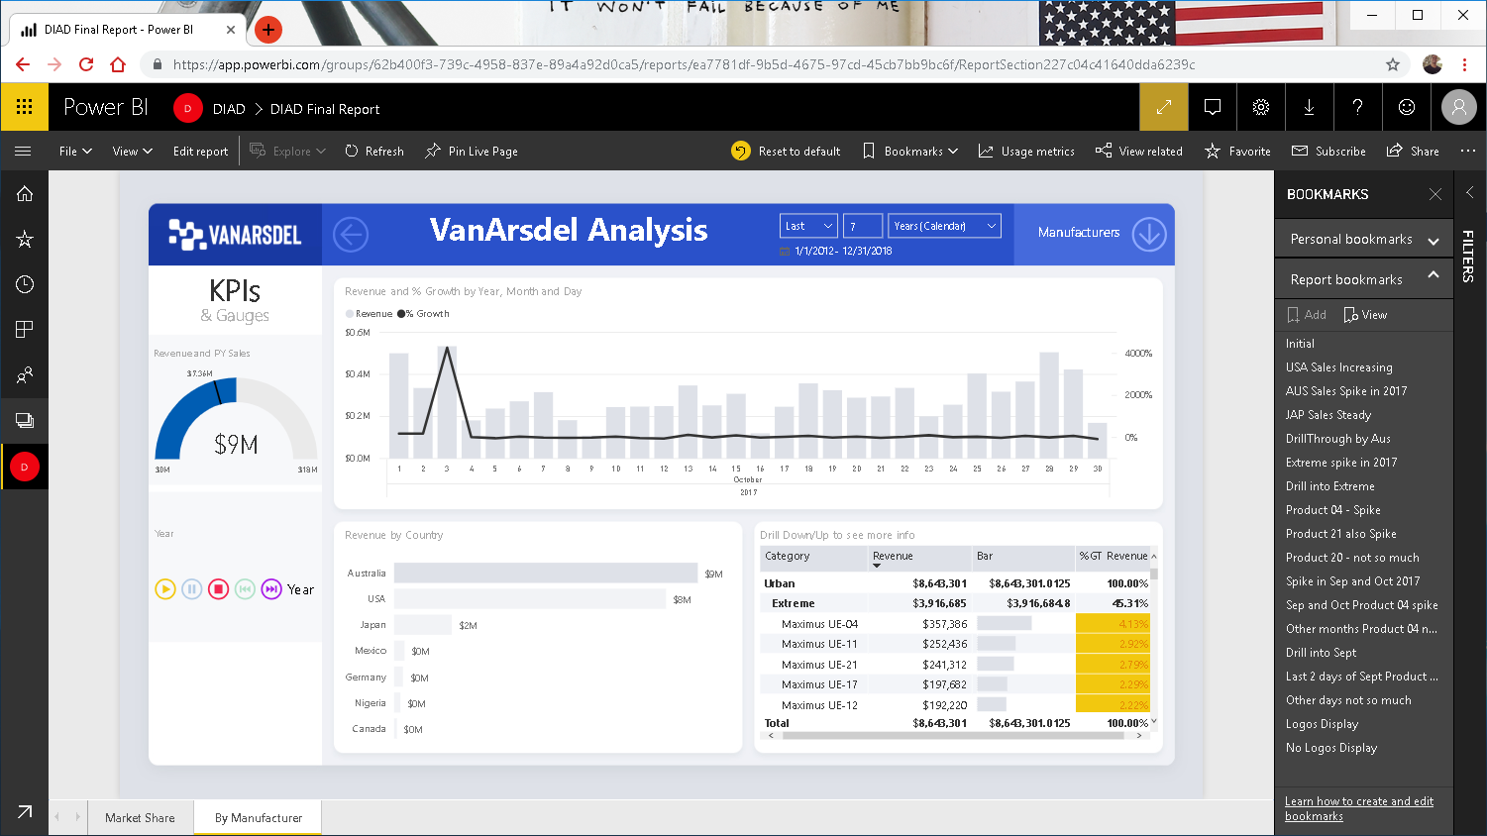
Notes:
Enable Full screen mode and navigate through a few bookmarks in presentation mode.

Slide 48
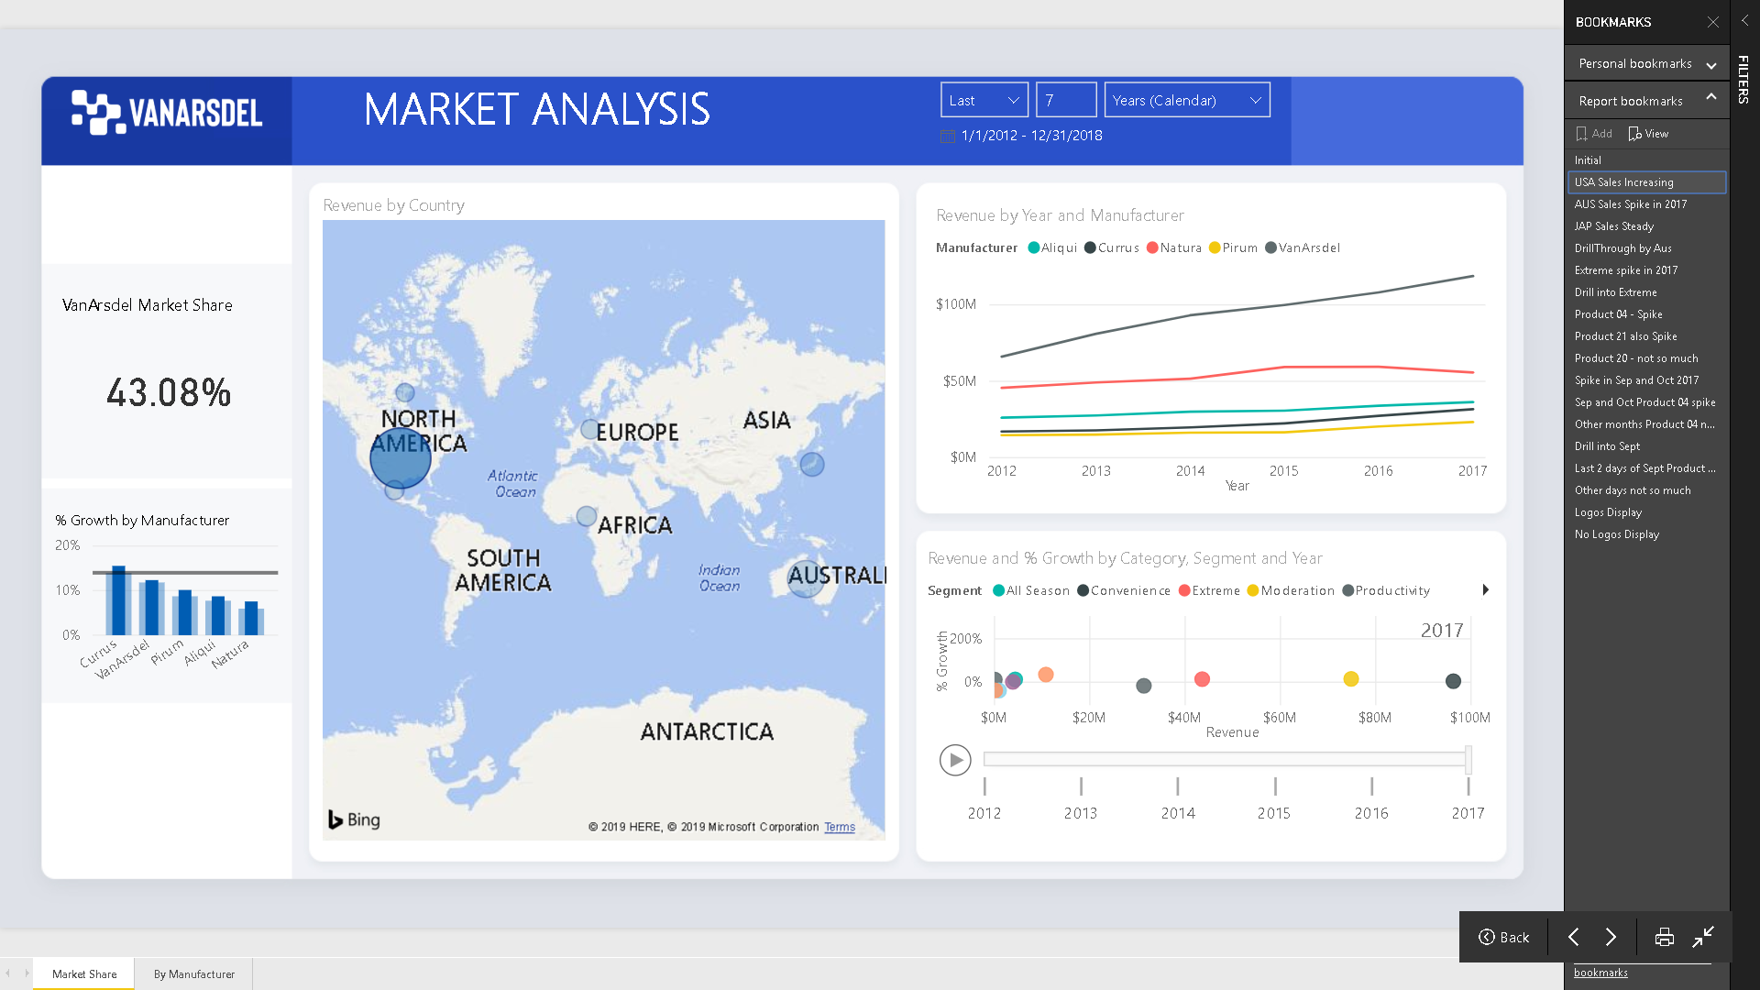
Notes:
Navigate through a few bookmarks in presentation mode.

Slide 49
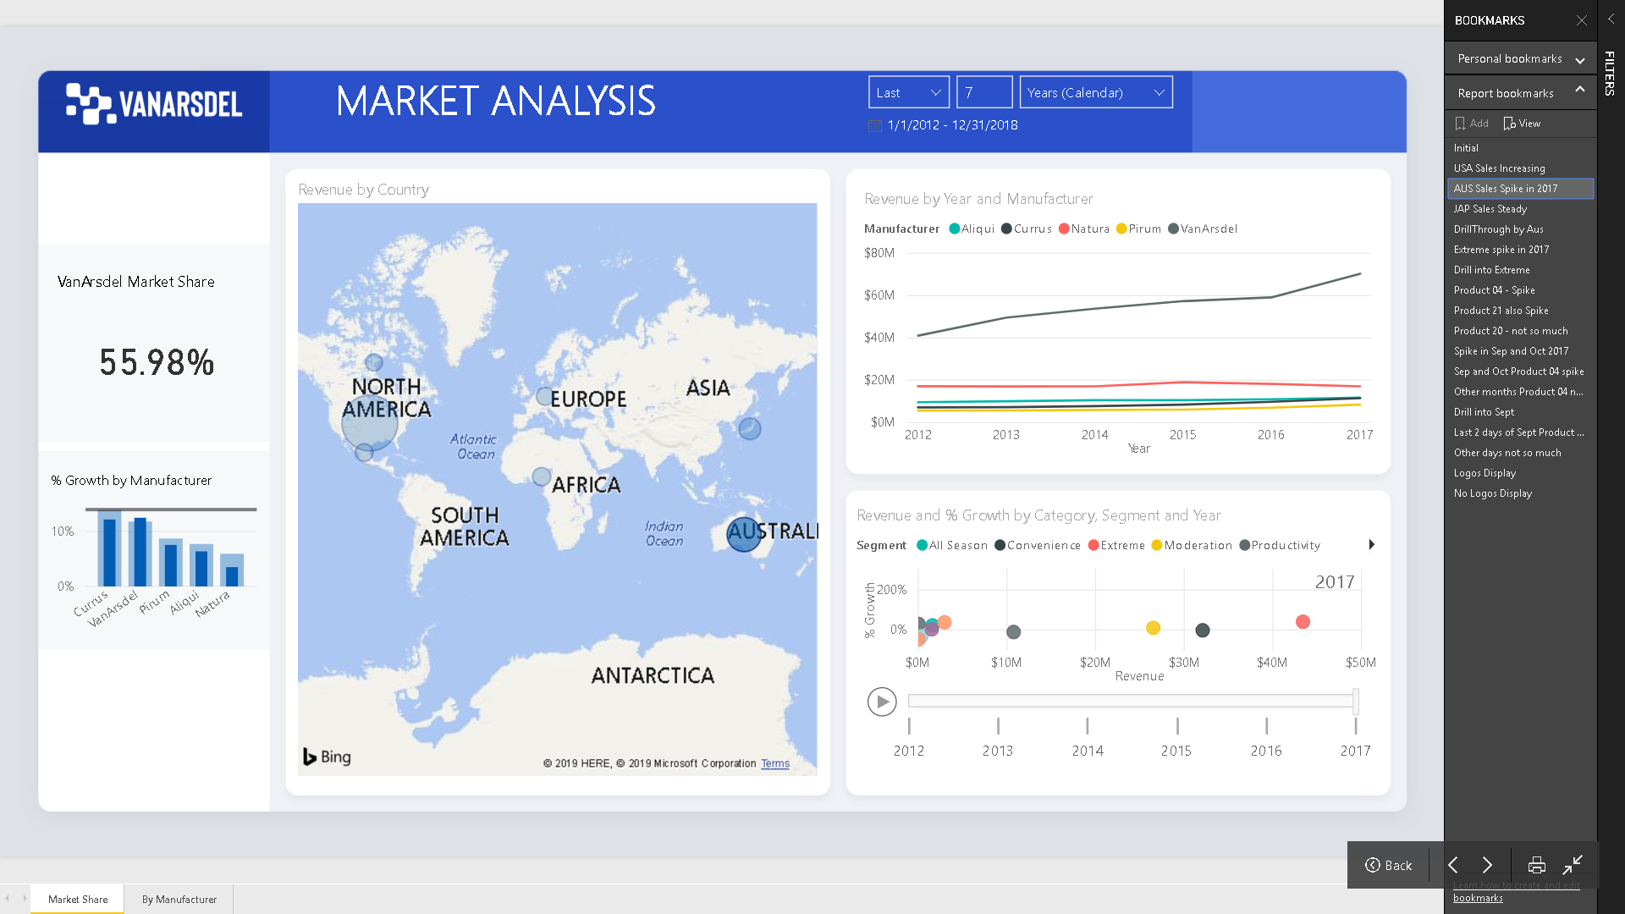
Notes:
The idea here is the ability to capture that moment and re-tell that story to the rest of the organization.

Slide 50
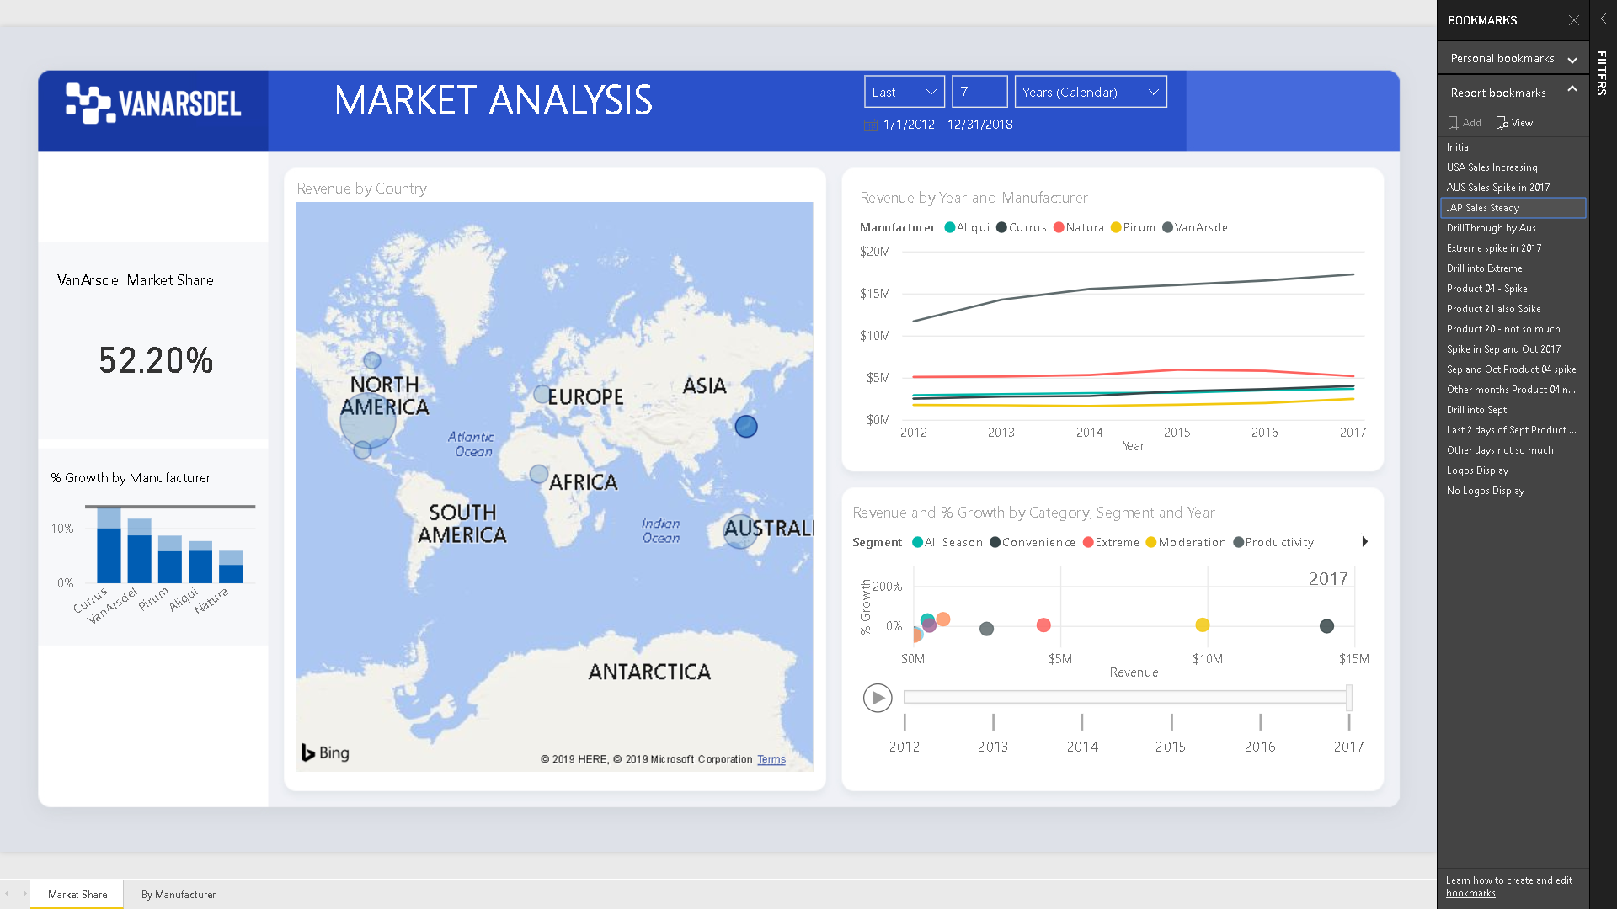
Notes:
The idea here is the ability to capture that moment and re-tell that story to the rest of the organization.

Slide 51
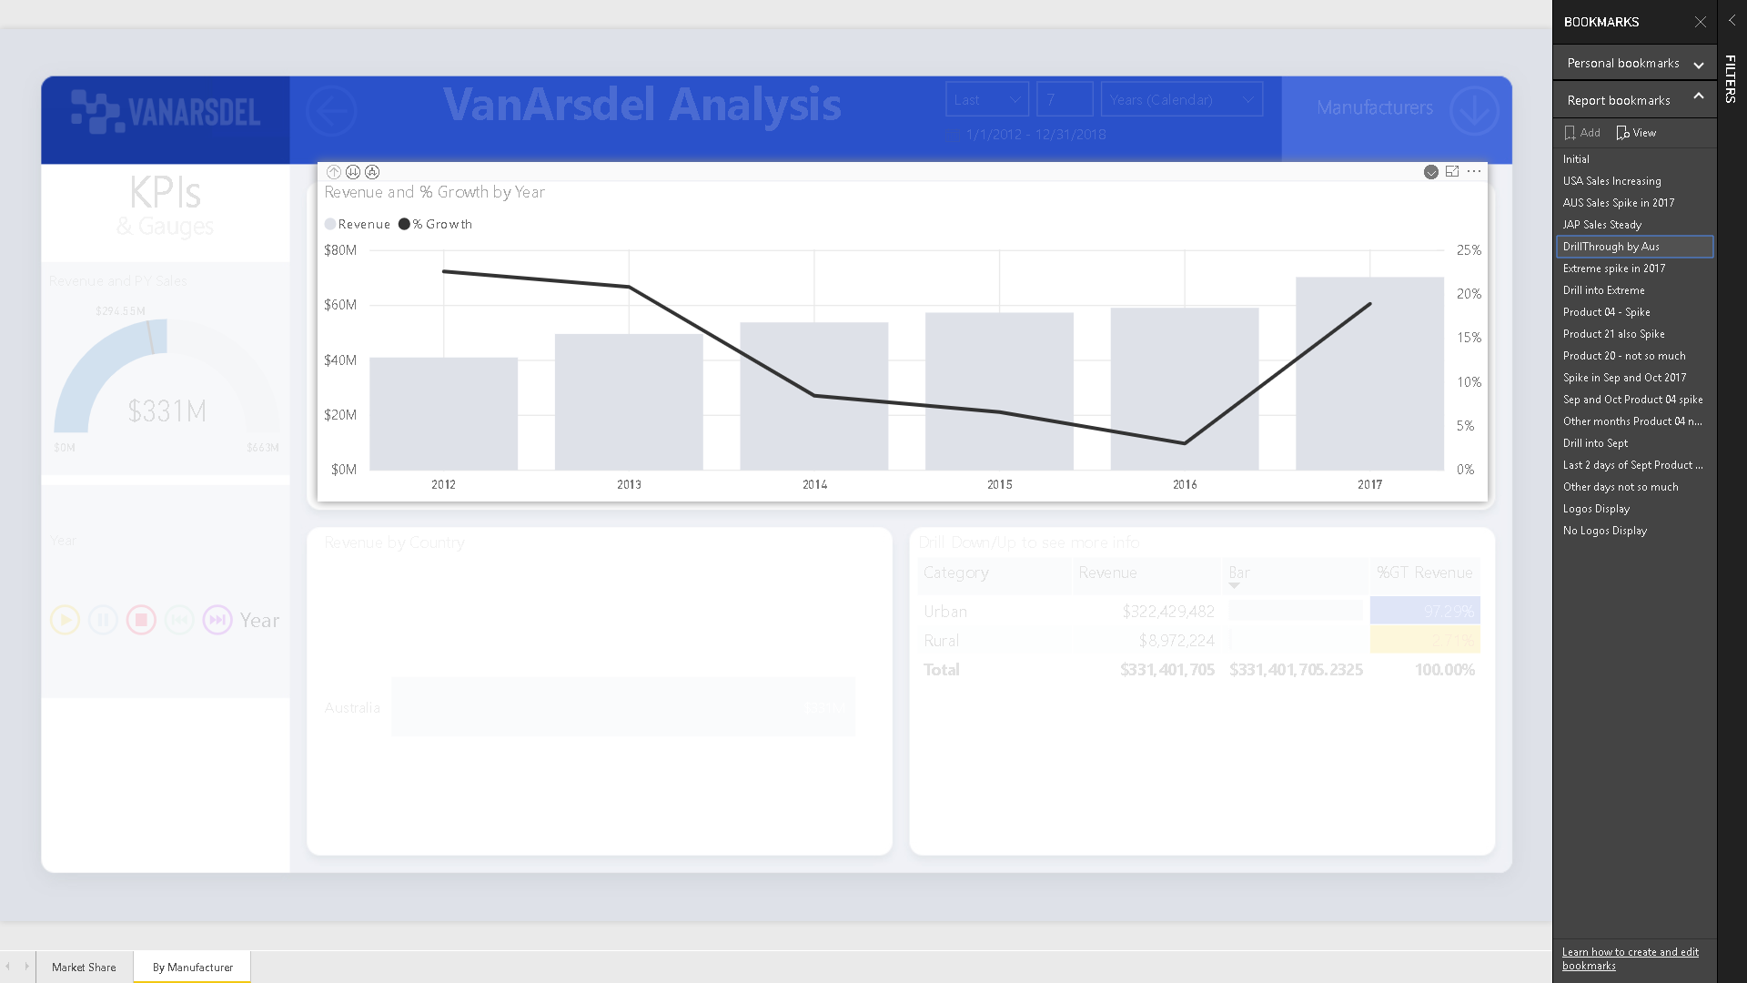
Notes:
The idea here is the ability to capture that moment and re-tell that story to the rest of the organization.

Slide 52
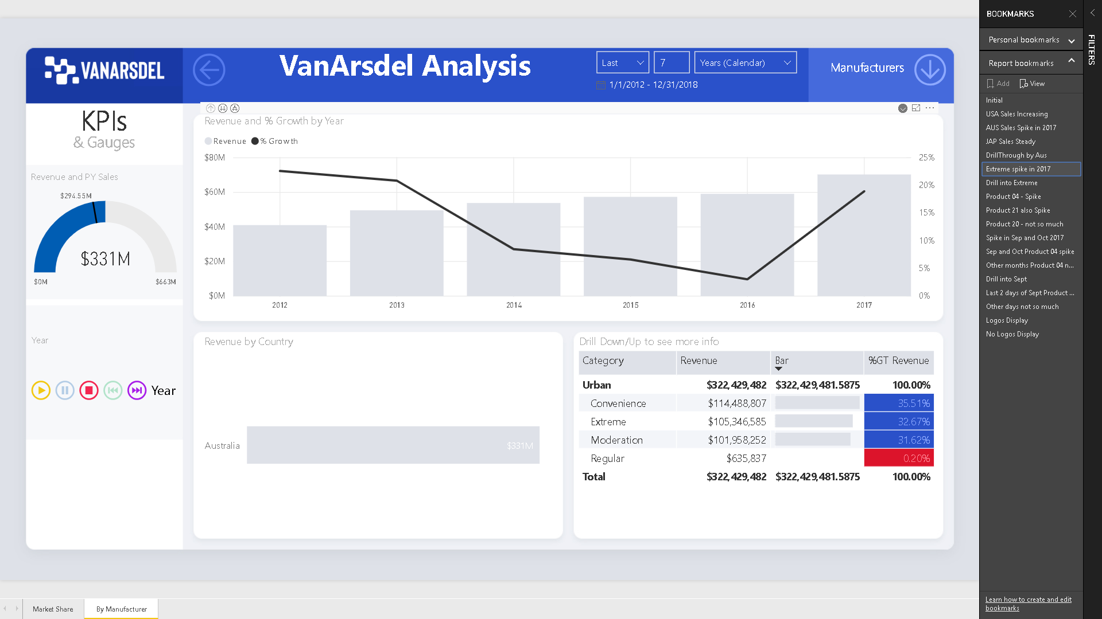
Notes:
The idea here is the ability to capture that moment and re-tell that story to the rest of the organization.

Slide 53
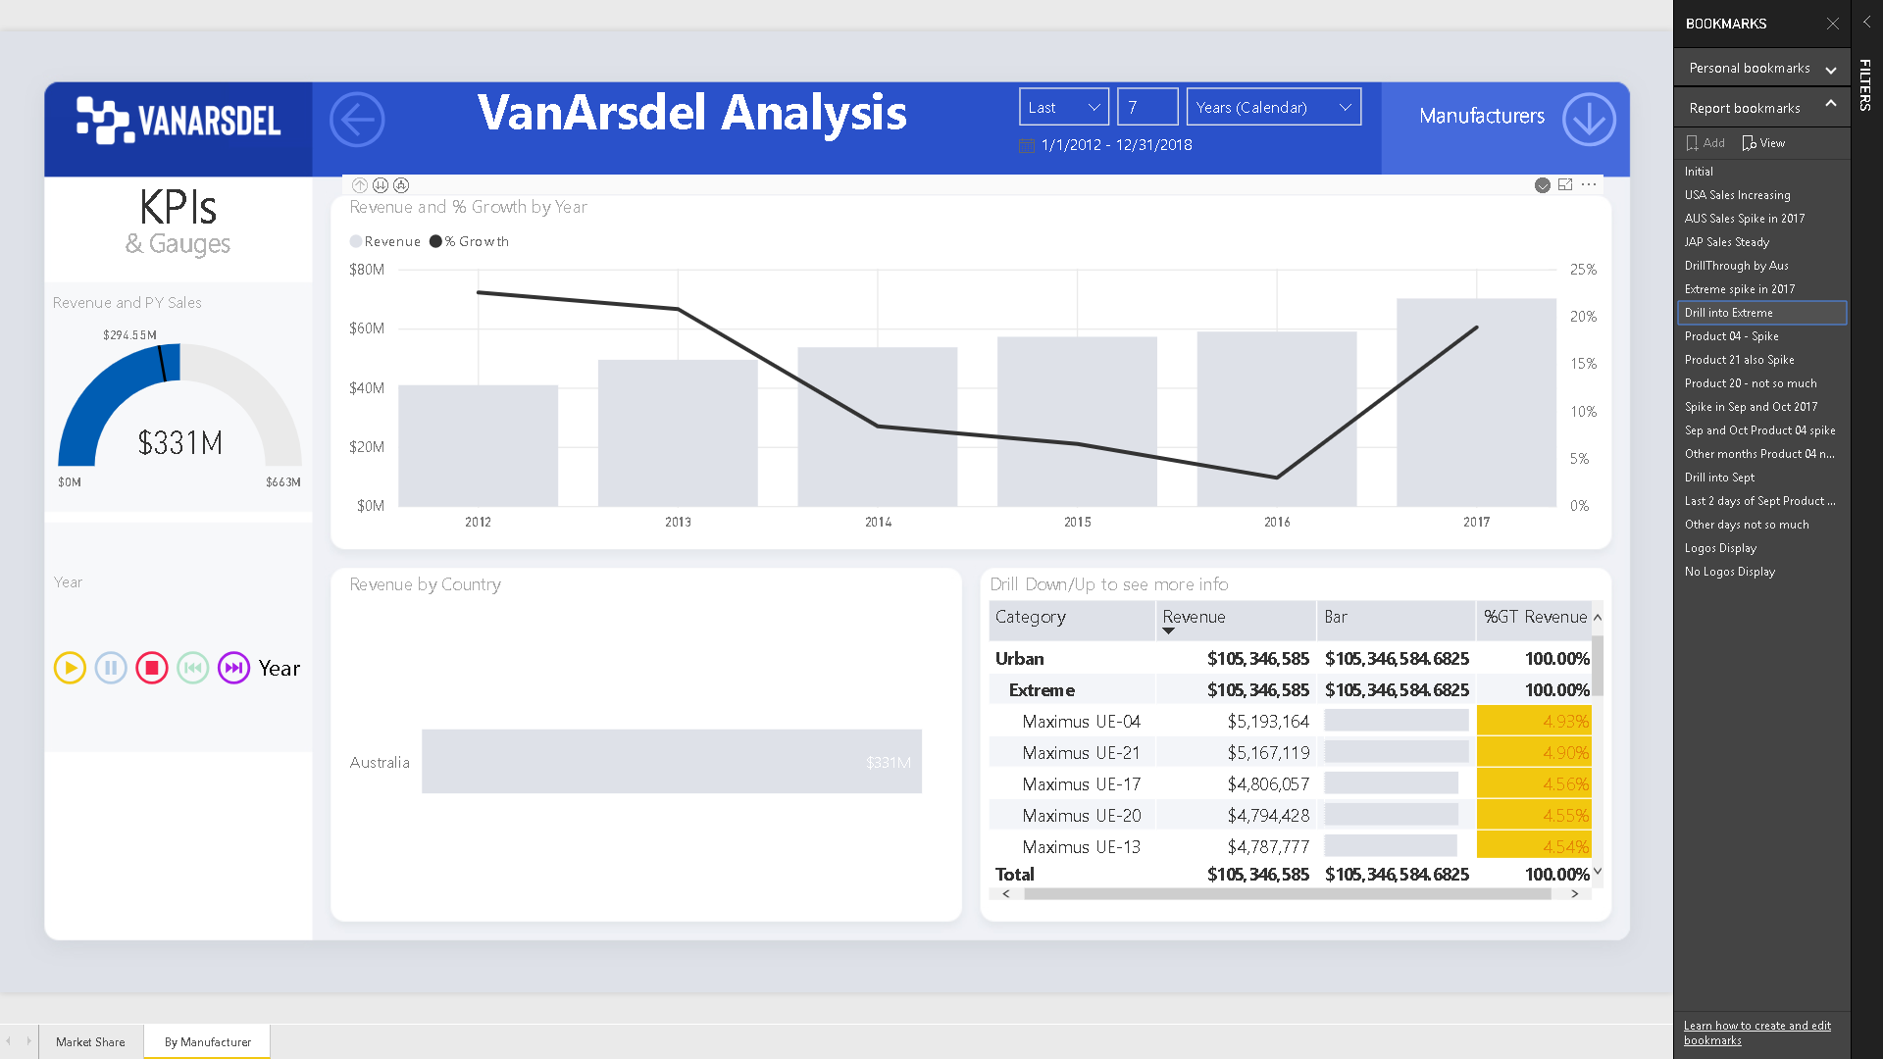
Notes:
The idea here is the ability to capture that moment and re-tell that story to the rest of the organization.

Slide 54
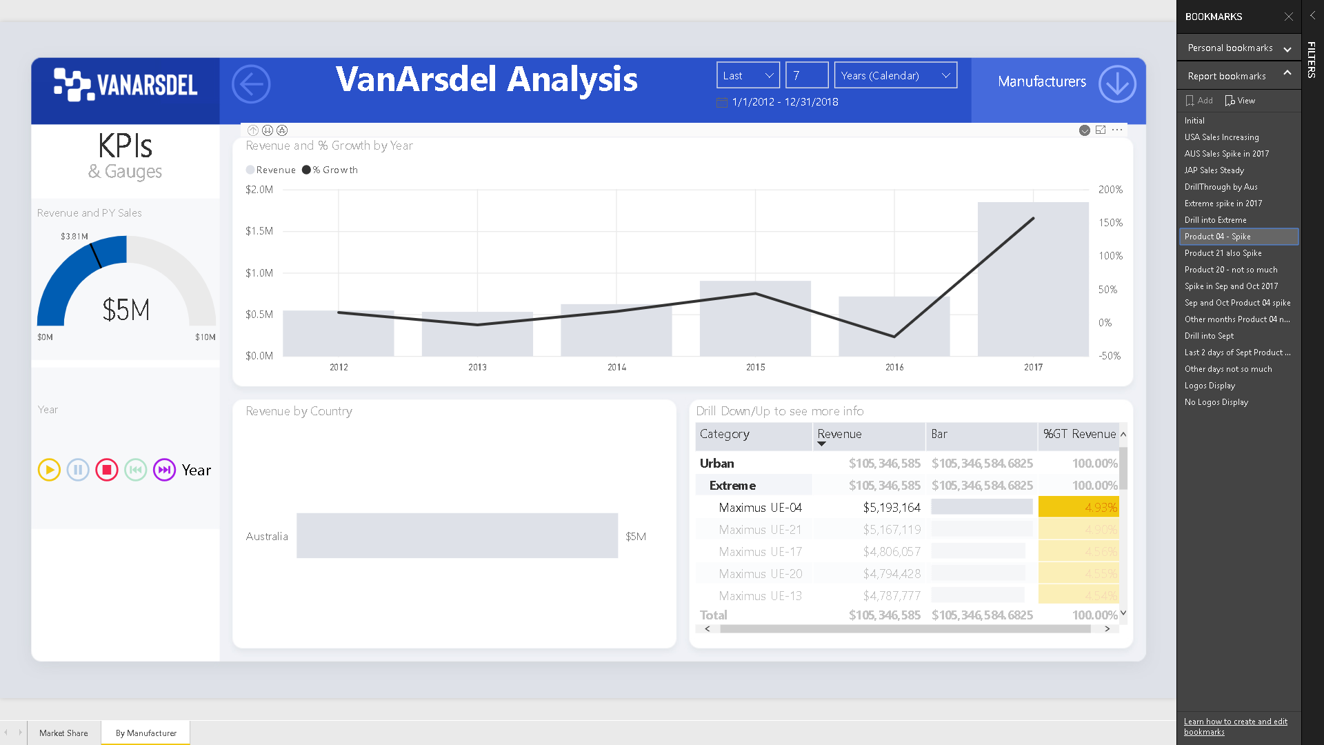
Notes:
The idea here is the ability to capture that moment and re-tell that story to the rest of the organization.

Slide 55
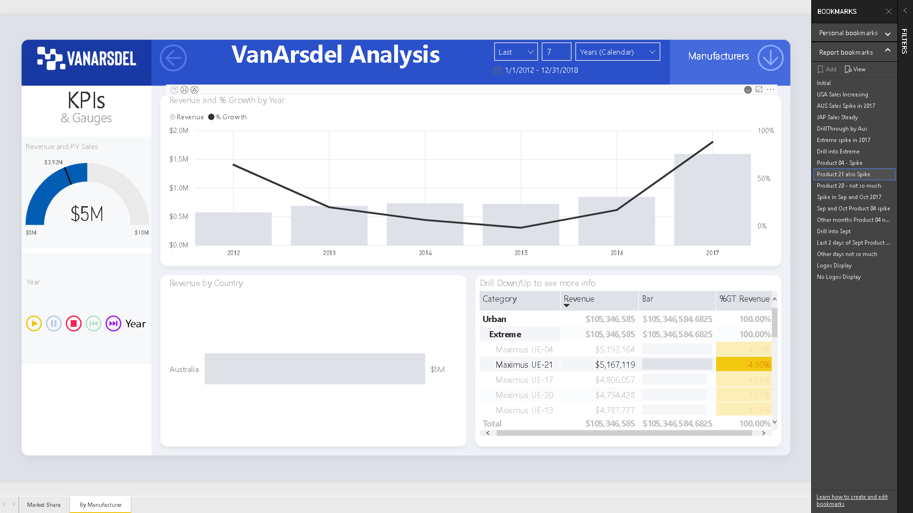
Notes:
The idea here is the ability to capture that moment and re-tell that story to the rest of the organization.

Slide 56
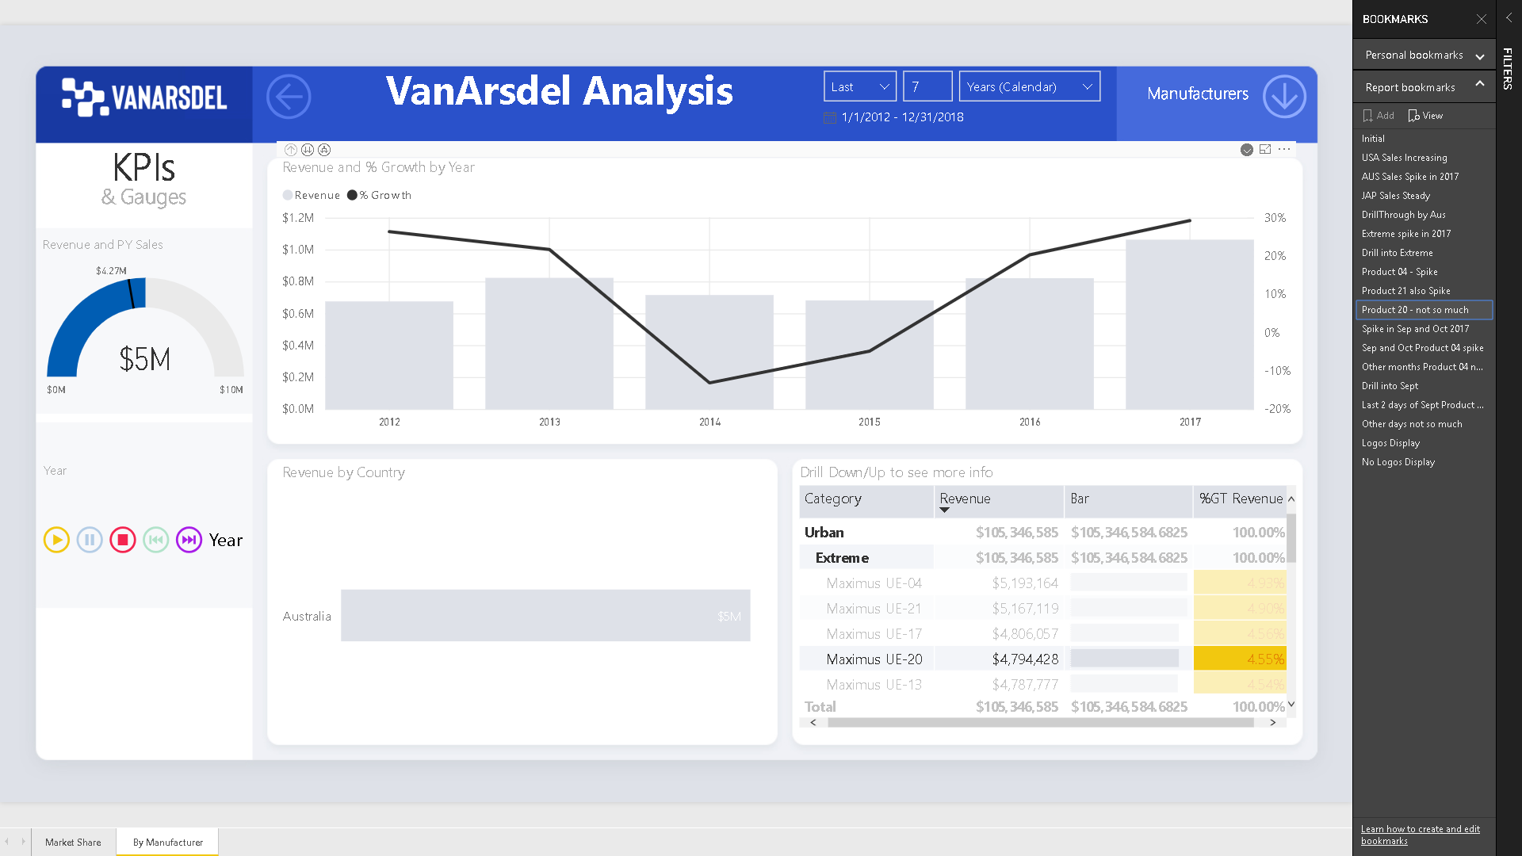
Notes:
The idea here is the ability to capture that moment and re-tell that story to the rest of the organization.

Slide 57
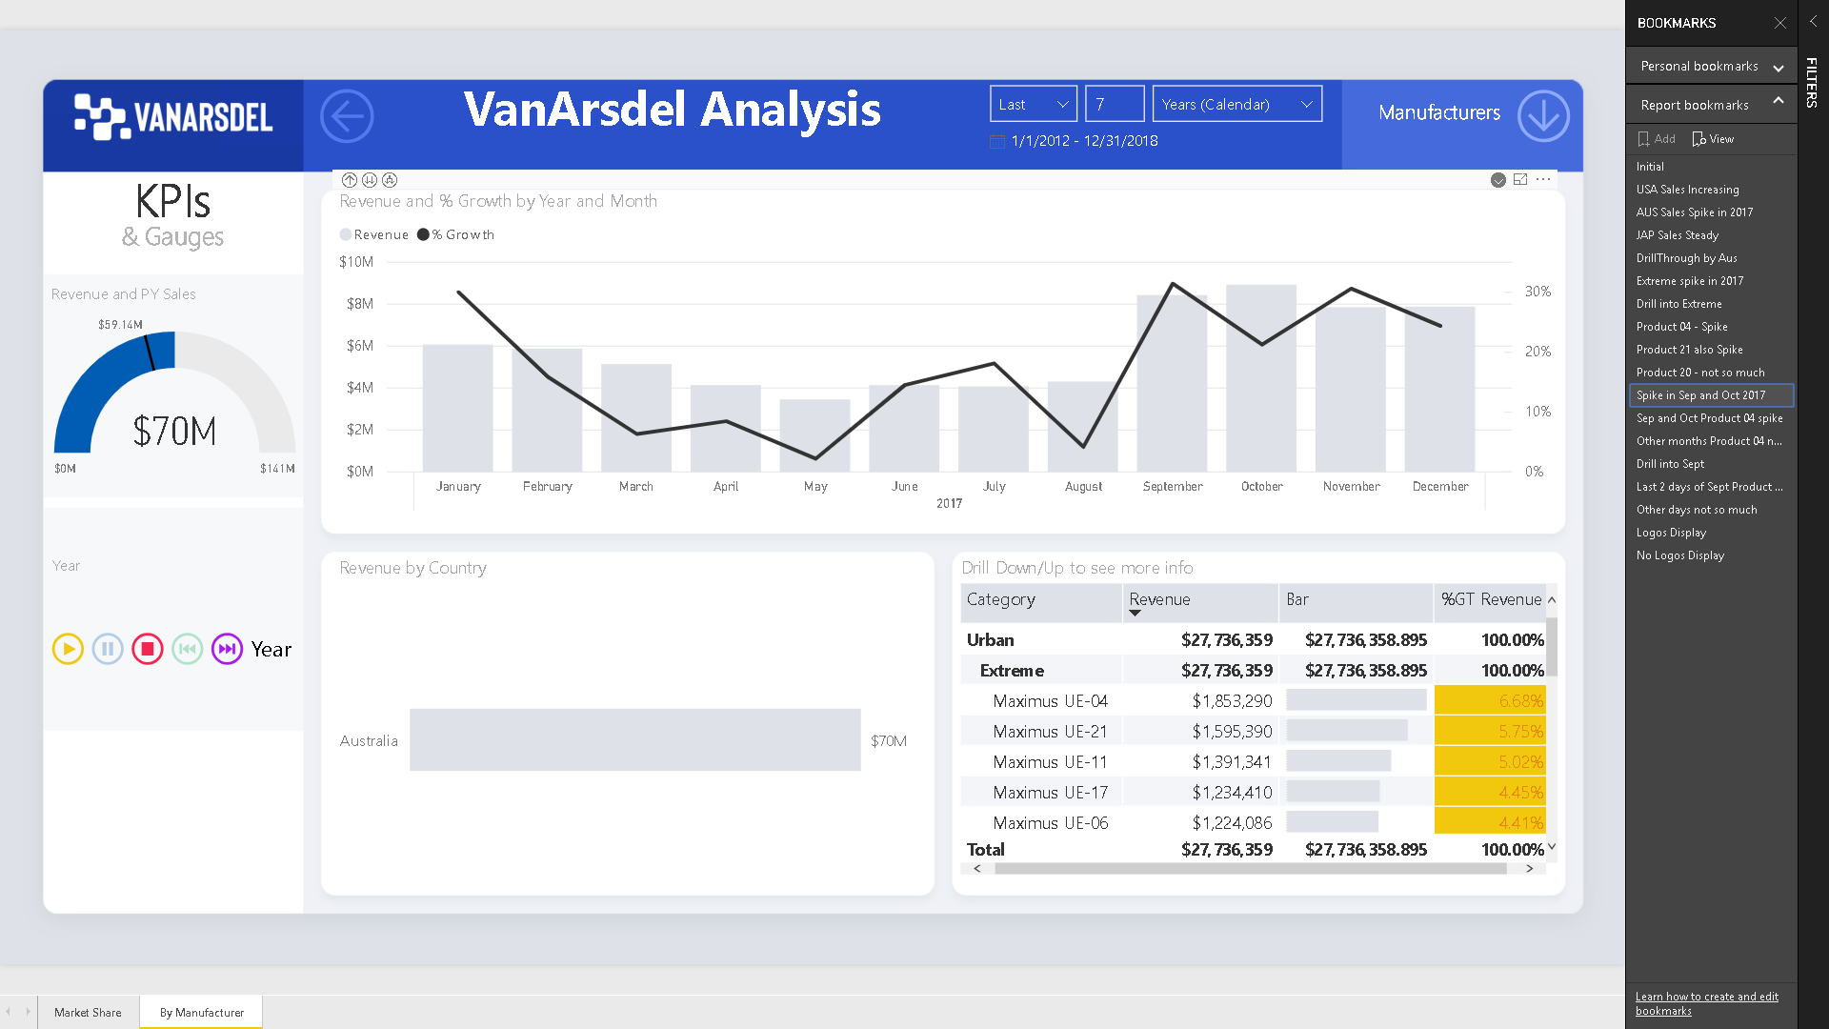
Notes:
The idea here is the ability to capture that moment and re-tell that story to the rest of the organization.

Slide 58
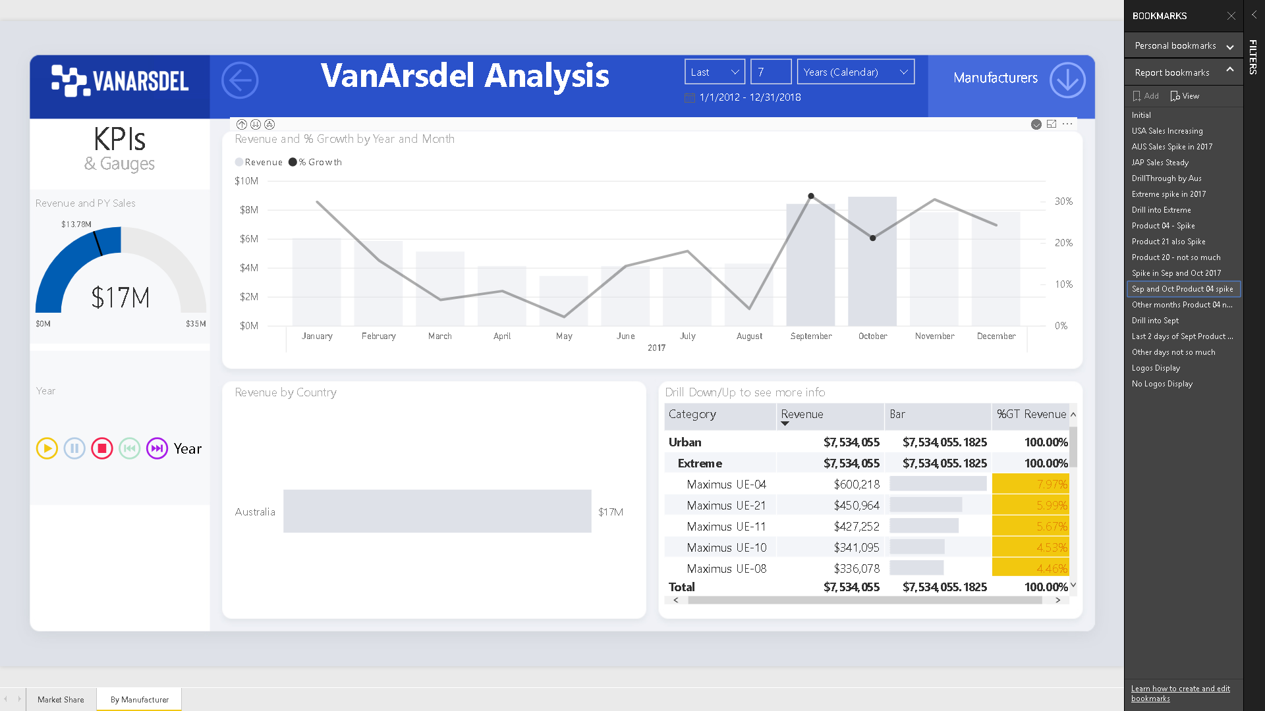
Notes:
The idea here is the ability to capture that moment and re-tell that story to the rest of the organization.

Slide 59

Notes:
The idea here is the ability to capture that moment and re-tell that story to the rest of the organization.

Slide 60
Notes:
The idea here is the ability to capture that moment and re-tell that story to the rest of the organization.

Slide 61
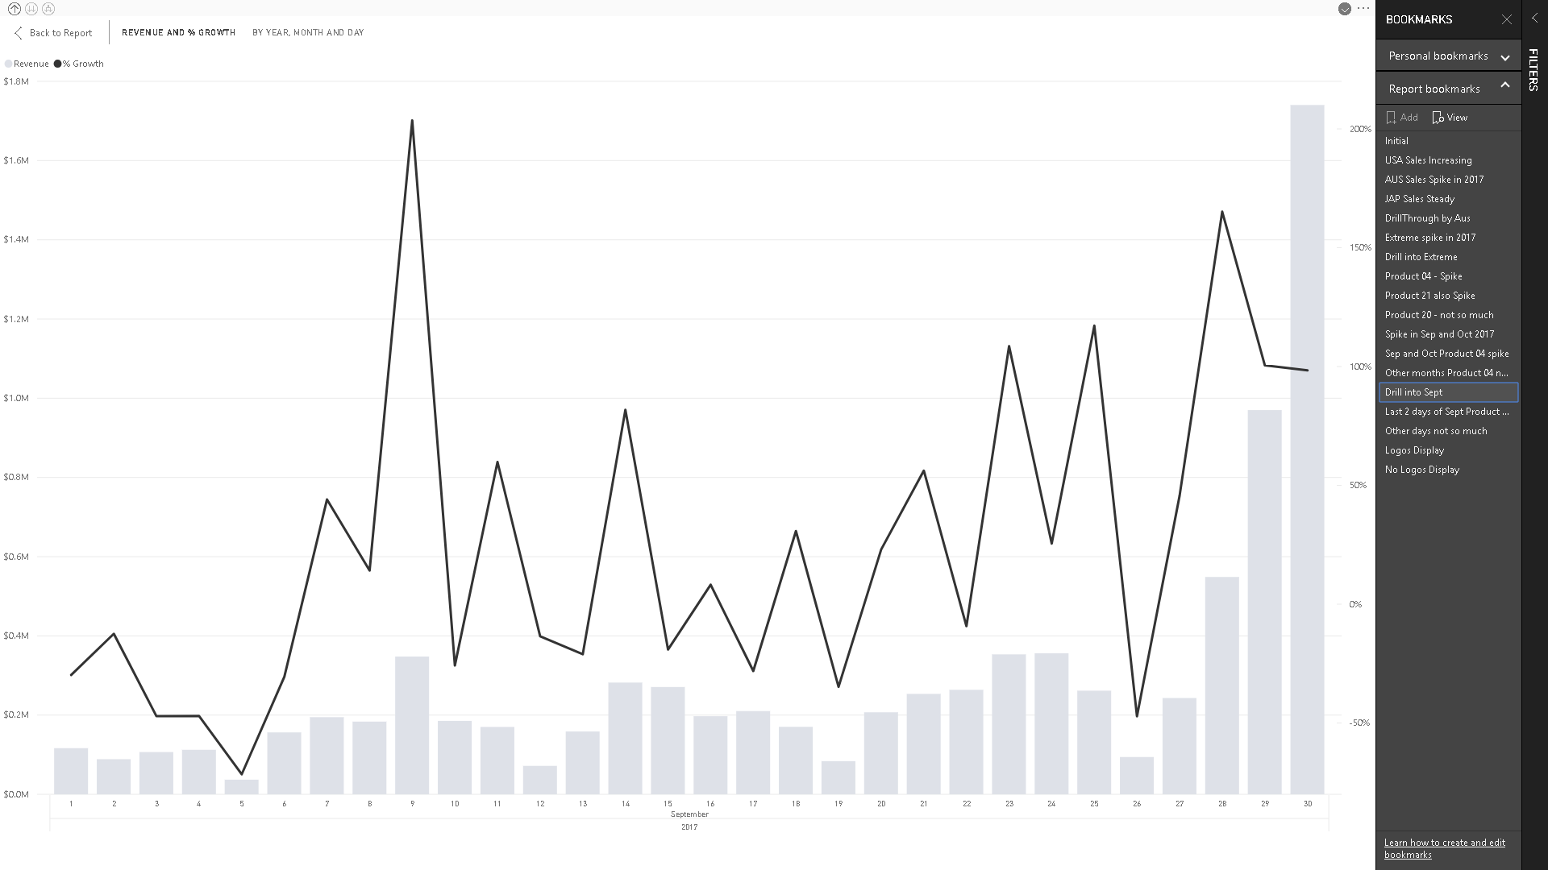
Notes:
The idea here is the ability to capture that moment and re-tell that story to the rest of the organization.

Slide 62
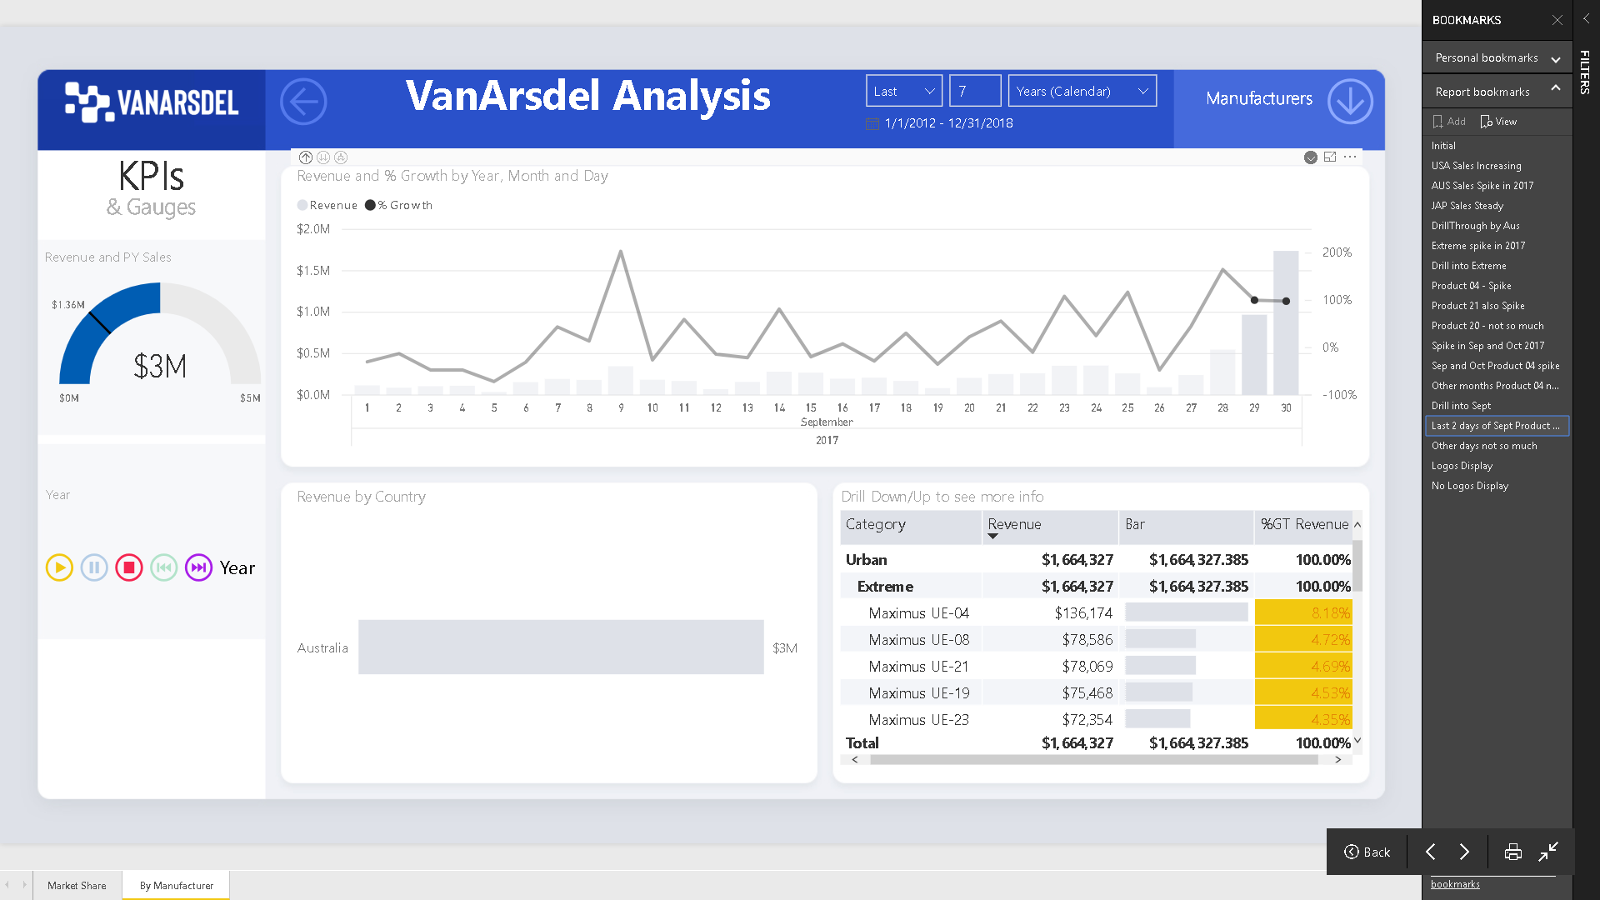
Notes:
The idea here is the ability to capture that moment and re-tell that story to the rest of the organization.

Slide 63
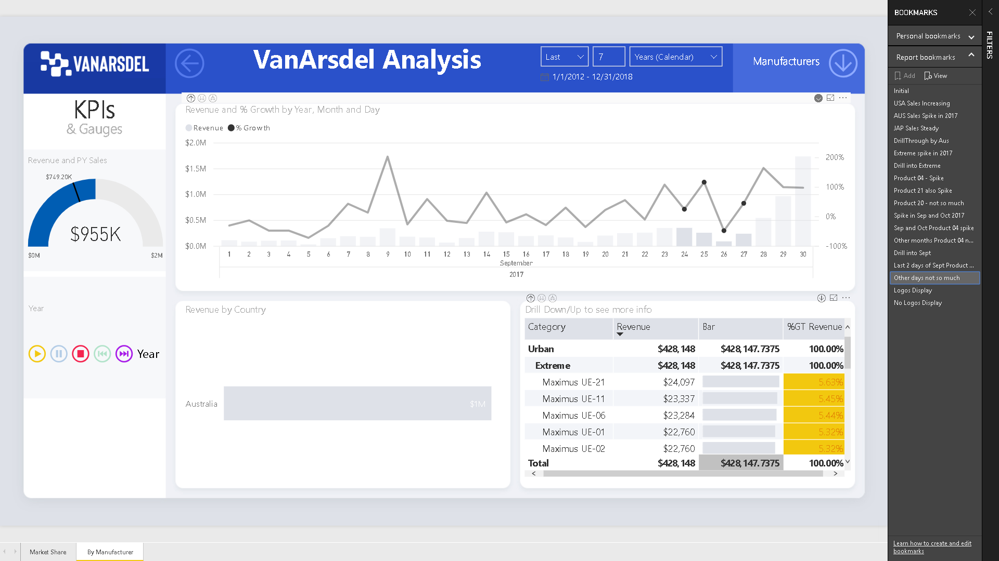
Notes:
The idea here is the ability to capture that moment and re-tell that story to the rest of the organization.

Slide 64
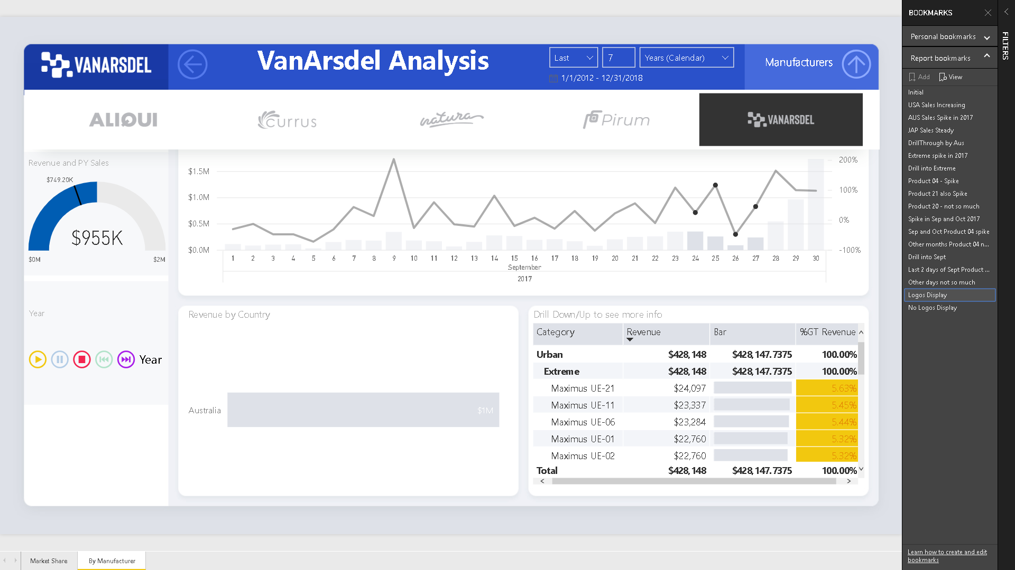
Notes:
The idea here is the ability to capture that moment and re-tell that story to the rest of the organization.

Slide 65

Notes:
The idea here is the ability to capture that moment and re-tell that story to the rest of the organization.

Slide 66
DEMO 3
Power BI
Twitter Data
Notes:
So what’s going on and is there a correlation with social media?

Slide 67
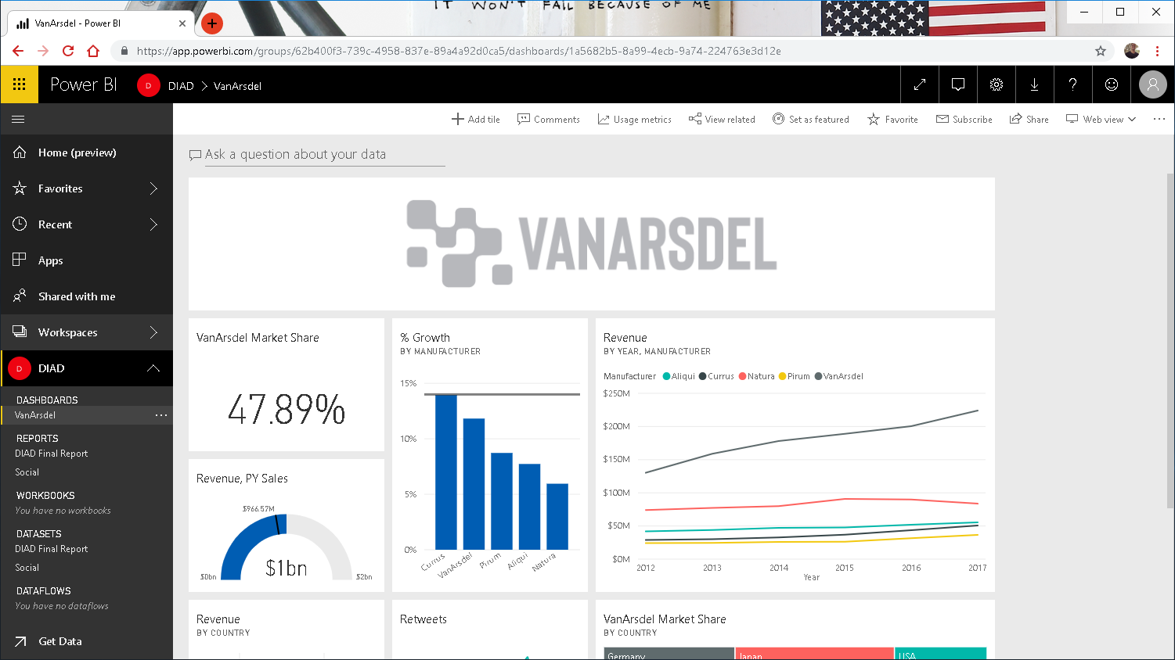

Slide 68


Slide 69

Notes:
In QnA text box type in “Retweetcount by date”.
Notice a line chart is created and there is a spike in retweets during our Spike period
Let’s focus in on 2017.

Slide 70

Notes:
Continue typing “Retweetcount by date in 2017 as line chart”
We can see that there is some correlation.
Let’s analyze the sentiment of these tweets.

Slide 71


Slide 72


Slide 73

Notes:
Continue typing “Average sentiment by year 2017”
Notice the sentiment score around September and October of 2017 is around the average of 0.11.
So that doesn’t help much.
Let’s look at the data by twitter handle.

Slide 74


Notes:
This time in QnA box, enter “Retweetcount by twitter handle as table in Sep 2017”
Order by retweetcount column descending.
Notice there is many tweets from a single tweet handle.
This handle belongs to the marketing department of VanArsdel.
We found the cause for the spike.
The social initiative by the marketing department lead to the spike in sales.
This information could be shared with other regions and they could potentially have a similar initiative to boost sales.
Hey marketing you are doing fantastic, look how much money you’ve earned us by just 453 tweets.
It’s all about noticing.
That’s what Power BI brings us, we can look and gather insights about this data.
Hopefully that was a fun and exciting.
Let’s look next at some pre-lab pointers.

Slide 75





Pre-Lab Pointers
Notes:
Lets look at a couple of the files we’re going to be working with as our sources.

Slide 76


Slide 77

Notes:
We have headers after the title Product Details.
The Product column appears to have more than just the product.
The Category column has a lot of empty cells.
This we can fix by Transforming the data.

Slide 78

Notes:
Data is laid out across the sheet
Doesn’t have any column headers
Has blank and extra rows
These are items we are going to have to amend.

Slide 79

Notes:
First 3 rows need to be eliminated, because the headers don’t start till row 4.
The City column contains more than just the City.

Slide 80

Notes:
Data from these sources need to be brought together to analyze and report on.

Slide 81


Notes:
Launch new instance of Power BI Desktop

Slide 82


Notes:
Once Power BI Desktop opens, startup screen opens as well
Close startup screen by clicking on “x” on the top right corner

Slide 83
Report View
4. Visualizations
1. Ribbon
2. Canvas
5. Fields
3. Pages
Notes:
The Report view has 5 main areas:
1. The Ribbon: displays common tasks associated with reports and visualizations
2. The Report view, or canvas, where visualizations are created and arranged
3. The Pages tab area along the bottom, which lets you select or add a report page
4. The Visualizations pane, where you can change visualizations, customize colors or axes, apply filters, drag fields, and more
5. The Fields pane, where query elements and filters can be dragged onto the Report view, or dragged to the Filters area of the Visualizations pane

Slide 84
Notes:
Now we are in Power BI Desktop.
At the top we have File, Home, View and Help.
Notice in the ribbon under Home, there are following categorization
Clipboard
External Data: This section is equivalent to Power Query for Excel. It is used to connect to various data sources and transform data.
Insert: Used to create elements in the report. Similar to Power View for Excel
Custom visuals: from File or Marketplace
Themes: Switch report colors.
Relationships: This section is used to create/edit relationships in the data model. It’s similar to Power Pivot for Excel
Calculations: This section is used to create/edit measures and calculated columns. It’s similar to Power Pivot for Excel
Share: This is used to Publish data model to Power BI Service

Slide 85

Notes:
Notice on the left panel, there is reports, data and relationship sections. These views provide capability to view data and relationships between tables

Slide 86

Notes:
Relationships

Slide 87

Create visuals or
view data here
Edit report
elements
Notes:
73. The center panel is the canvas used to create visuals or view data
74. Right panel is used to add/edit report elements
75. Also notice the Modeling ribbon option, that provides option to Add Columns, Add Measures and other modeling options

Slide 88


Notes:
From the ribbon select Home -> Get Data -> More…
Talk about the variety of sources supported:
• File
• Database
• Azure
• Other

Slide 89


Notes:
From the ribbon select Home -> Get Data -> More…
Talk about the variety of sources supported:
• File
• Database
• Azure
• Other

Slide 90

Notes:
From the ribbon select Home -> Get Data -> More…
Talk about the variety of sources supported:
• File
• Database
• Azure
• Other

Slide 91

Notes:
From the ribbon select Home -> Get Data -> More…
Talk about the variety of sources supported:
• File
• Database
• Azure
• Other

Slide 92

Notes:
From the ribbon select Home -> Get Data -> More…
Talk about the variety of sources supported:
• File
• Database
• Azure
• Other

Slide 93

Notes:
Switch to DIAD-Final Report.pbix

Slide 94

Notes:
Click Edit Queries, under Home, to open the Query Editor.

Slide 95

Notes:
5 queries are created from the 1 workbook, a csv file and a folder data source.
There are data preparation and transformation options.
• Add/Delete Columns and Rows
• Change Data Type
Select Sales query
83. Walk through the APPLIED STEPS
84. Talk about Append in Sales and difference between Append and Merge
85. Talk about Add Conditional column
86. Talk about Query Dependencies
87. Close Query Editor window
88. If you have time, talk about data transformations performed in the other queries

Slide 96

Notes:
Operations under Transform menu

Slide 97

Notes:
Operations under Add Column menu

Slide 98

Notes:
Select Sales query
84. Talk about Append in Sales and difference between Append and Merge
85. Talk about Add Conditional column
86. Talk about Query Dependencies

Slide 99

Notes:
84. Talk about Append in Sales and difference between Append and Merge
85. Talk about Add Conditional column
86. Talk about Query Dependencies

Slide 100

Notes:
84. Talk about Append in Sales and difference between Append and Merge
85. Talk about Add Conditional column
86. Talk about Query Dependencies

Slide 101

Notes:
84. Talk about Append in Sales and difference between Append and Merge
85. Talk about Add Conditional column
86. Talk about Query Dependencies

Slide 102

Notes:
84. Talk about Append in Sales and difference between Append and Merge
85. Talk about Add Conditional column
86. Talk about Query Dependencies

Slide 103

Notes:
84. Talk about Append in Sales and difference between Append and Merge
85. Talk about Add Conditional column
86. Talk about Query Dependencies
87. Close Query Editor window

Slide 104

Notes:
Navigate to Relationships section
90. Talk about the relationships that are created to connect all the queries
91. Click on Manage Relationships and show the dialogue
92. Talk about 1:1 and 1:M relationships that are supported by Power BI Desktop
93. Depending on the audience might want to talk about bi-direction relationship
94. Talk about Synonyms

Slide 105


Slide 106

Hide Ribbon
Report View
Right click
Notes:
95. Navigate back Reports section,
96. Talk about Fields and Visualization section
97. Talk about ability to Hide/Unhide fields and tables

Slide 107

Notes:
Go to the Data view
98. Notice we have a Date table which was not part of the query in Query Editor
99. Select Date table and talk about the DAX capability to create a table
100. Navigate to each of the columns in Date table and talk about calculated column feature

Slide 108

Notes:
98. Notice we have a Date table which was not part of the query in Query Editor
99. Select Date table and talk about the DAX capability to create a table
100. Navigate to each of the columns in Date table and talk about calculated column feature

Slide 109

Notes:
98. Notice we have a Date table which was not part of the query in Query Editor
99. Select Date table and talk about the DAX capability to create a table
100. Navigate to each of the columns in Date table and talk about calculated column feature

Slide 110

Notes:
98. Notice we have a Date table which was not part of the query in Query Editor
99. Select Date table and talk about the DAX capability to create a table
100. Navigate to each of the columns in Date table and talk about calculated column feature

Slide 111

Notes:
101. Talk about filtering options:
• Visual level filters
• Page level filters
• Report level filters
• Drillthrough filters
102. In Market Share report page, select Scatter chart to explain Visual level filter

Slide 112

Notes:
101. Talk about filtering options:
• Visual level filters
• Page level filters
• Report level filters
• Drillthrough filters
102. In Market Share report page, select Scatter chart to explain Visual level filter

Slide 113

Notes:
101. Talk about filtering options:
• Visual level filters
• Page level filters
• Report level filters
• Drillthrough filters
102. In Market Share report page, select Scatter chart to explain Visual level filter

Slide 114

Notes:
101. Talk about filtering options:
• Visual level filters
• Page level filters
• Report level filters
• Drillthrough filters
102. In Market Share report page, select Scatter chart to explain Visual level filter

Slide 115

Notes:
101. Talk about filtering options:
• Visual level filters
• Page level filters
• Report level filters
• Drillthrough filters
102. In Market Share report page, select Scatter chart to explain Visual level filter

Slide 116

Notes:
101. Talk about filtering options: All about Scope.
• Visual level filters
• Page level filters
• Report level filters
• Drillthrough filters – This is a fun one, which is how we can make pages communicate with each other.
102. In Market Share report page, select Scatter chart to explain Visual level filter

Slide 117

Notes:
Navigate to By Manufacturer report page
Notice we already have a drill through by Country.
This is known as a drill through report, but we also want to drill through by Manufacture.

Slide 118

Notes:
Contextual Search Manufacture.

Slide 119

Notes:
Simply drag the Manufacture field/column into drill through.
And now we can drill through into this page by Manufacture.
Do not apply any filters for manufacture at this point.
Note also the Card Display says Manufacture Analysis.

Slide 120

Notes:
The Card Display is not filtered at this point is for ALL manufactures.
We can go back to the Market Share page, right click a manufacture
and Pass-Through the value into this page.
Let’s go back to Market Share report page and see that in action.

Slide 121

Notes:
Notice in % Growth by Manufacturer column chart, Currus has the best growth. Let’s investigate.

Slide 122

Notes:
Right click on Currus bar and select Drillthrough -> By Manufacturer to be navigated to By Manufacturer page

Slide 123

Notes:
Now this visual is showing all the values for this 1 manufacture.
Use the matrix visual in By Manufacturer page to talk about Drill up/down capability
109. Use focus mode on the matrix visual
110. Talk about all the other features in Data/Drill menu
111. Notice the most growth is in Extreme and Convenience segment
112. Once done, click Back to Report

Slide 124

Notes:
Click Focus mode

Slide 125

Notes:
These icons show that there is a hierarchy of these 3 fields (Products -> Segments -> Category)
They also indicate whether we’ve drilled down or up on this visual.

Slide 126

Notes:
Click Expand all one level and see
Notice the most growth is in Extreme and Convenience segment
Once done, click Back to Report

Slide 127

Notes:
Click Expand again one more level and notice the nice color distribution, this is also known as Conditional Formatting.
Lets click Back to Report

Slide 128

Notes:
Click New Page. Leave it as Page 1 for now.
From By Manufacturer page copy the Manufacturer logo slicer.

Slide 129

Notes:
Lets copy the logo slicer Ctrl + click the arrow to show the logos and click Copy.

Slide 130

Notes:
Paste, and Sync the slicer.

Slide 131

Notes:
Click View, check Sync slicers, this will the Sync Slicer panel.
Meaning whatever we choose this visual will be synced back to the same visual slicer in the By Manufacture page.
Affects the assigned pages.
117. Filter by Currus

Slide 132

Notes:
Lets use the Q&A feature by click Ask A Question or simply double click on the canvas.

Slide 133

Notes:
Enter % Growth by Country
Notice Currus has a big presence in Mexico
Resize it to see the distribution better and lets add a slicer.

Slide 134

Notes:
Click Slicer and lets filter by Year.

Slide 135

Notes:
This is a numeric rage slicer, notice how it affects the other visual % Growth by Country on our page.
We can switch this to a drop down or list.

Slide 136

Notes:
Click to change the type of slicer and choose Dropdown.

Slide 137

Notes:
The dropdown is nice to save space on the canvas.
But a list can be made to look very interesting.

Slide 138

Notes:
Select 2017 in the slicer.
Notice that Currus had a big impact in Nigeria in 2017

Slide 139

Notes:
Lets set the type of slicer to a list.

Slide 140

Notes:
Click Format, and change the Orientation from Vertical to Horizontal.
We get this look & feel as if it was a button!

Slide 141

Notes:
Here I’ve resized it and lets change the colors.

Slide 142

Notes:
Click Format, under Items, change the Font Color to white to standout, and Background to blue as the other visual.

Slide 143

Notes:
Notice how Nigeria had negative growth in 2016.

Slide 144

Notes:
Create a matrix visual with Product Hierarchy in Rows and Revenue and PY Revenue in Values section

Slide 145

Notes:
Create a matrix visual with Product Hierarchy in Rows and Revenue and PY Revenue in Values section

Slide 146

Notes:
131. Apply conditional formatting on Revenue so that Revenue is formatted based on % Growth. Thus, highlighting capability to format based on another field

Slide 147

Notes:
Click the down tick next to the Revenue value, select Conditional Formatting, Background color.

Slide 148

Notes:
Choose Based on % Growth
check Diverging to add a Mid value color.
And click OK.

Slide 149

Notes:
I’ve increased this visual’s Font size format for Column headers, Row headers, and Values to make this legible.

Slide 150

Notes:
Select Nigeria in the bar chart and notice that Currus has growth in Urban and Youth Product categories.
You’d expect it to have been Rural, since it has a higher Revenue, but the contributors to the Growth were Urban and Youth.
133. investigate further by drilling down the Product hierarchy

Slide 151

Notes:
Investigate further by drilling down the Product hierarchy.
We can see for the Urban category the contributors to the % Growth were Convenience and Extreme segments.

Slide 152

Notes:
Move things around and resize them to give some room.
Then add a Scatter chart visual, and add Units to the X-Axis.

Slide 153

Notes:
Set the calculation to Average of Units instead of the default Sum.

Slide 154

Notes:
Do the same for Average Revenue to he Y-Axis

Slide 155

Notes:
From the Fields section, add Product to Details

Slide 156

Notes:
Lets leverage the Power BI underlying clustering algorithm by telling the Scatter chart to Automatically find clusters.
Click the ellipses on the top right of the visual for More Options and choose Automatically find clusters.

Slide 157

Notes:
Cluster dialog opens. Change the number of clusters if you wish to, if not leave the default and click OK.
It’s going to say Working… for a moment.

Slide 158

Notes:
Notice the Scatter chart has updated to show clusters using the clustering algorithm.
You can use clusters to identify outliers and patterns.

Slide 159

Notes:
Select the outlier Cluster7 in the Scatter chart.
Notice they make a huge chunk of the revenue in Nigeria and Canada.
Something to look into…

Slide 160

Notes:
If we sort by Revenue the product matrix we see Currus UC-26 is the outlier in Cluster7 with the highest Average of Units and Average of Revenue in Nigeria and Canada.

Slide 161

Begin Lab
Notes:
That’s a lot of elements we covered.
We talked about the Power BI Desktop tool, Get Data, Look and Feel, Visuals, Fields, Formatting.
Hopefully, this has demystified things a little.
DIAD Pre-lab Quiz: https://goo.gl/e1r2iq
So lets start the lab itself.

Slide 162
DEMO +
Slicer Between
Bookmarks
Analytics
Mobile
Notes:
So what’s going on and is there a correlation with social media?

Slide 163

Notes:
Note: This demo is to show slicers is available on numeric and dimension fields
147. Add a Revenue slicer
148. Let’s use the slicer to take out the outliers
149. Use the slicer to keep Revenue between 1000 and 40000.
150. Notice with this selection, Germany, Japan and Mexico have negative growth

Slide 164

Notes:
151. Enable Bookmark pane.
152. Walk through the existing Bookmarks and the use case for bookmarks.
153. Feel free to add new bookmarks for Currus story that we started investigating

Slide 165

Notes:
151. Enable Bookmark pane.
152. Walk through the existing Bookmarks and the use case for bookmarks.
153. Feel free to add new bookmarks for Currus story that we started investigating

Slide 166

Notes:
151. Enable Bookmark pane.
152. Walk through the existing Bookmarks and the use case for bookmarks.
153. Feel free to add new bookmarks for Currus story that we started investigating

Slide 167

Notes:
151. Enable Bookmark pane.
152. Walk through the existing Bookmarks and the use case for bookmarks.
153. Feel free to add new bookmarks for Currus story that we started investigating

Slide 168

Notes:
151. Enable Bookmark pane.
152. Walk through the existing Bookmarks and the use case for bookmarks.
153. Feel free to add new bookmarks for Currus story that we started investigating

Slide 169

Notes:
151. Enable Bookmark pane.
152. Walk through the existing Bookmarks and the use case for bookmarks.
153. Feel free to add new bookmarks for Currus story that we started investigating

Slide 170

Notes:
151. Enable Bookmark pane.
152. Walk through the existing Bookmarks and the use case for bookmarks.
153. Feel free to add new bookmarks for Currus story that we started investigating

Slide 171

Notes:
151. Enable Bookmark pane.
152. Walk through the existing Bookmarks and the use case for bookmarks.
153. Feel free to add new bookmarks for Currus story that we started investigating

Slide 172

Notes:
151. Enable Bookmark pane.
152. Walk through the existing Bookmarks and the use case for bookmarks.
153. Feel free to add new bookmarks for Currus story that we started investigating

Slide 173

Notes:
151. Enable Bookmark pane.
152. Walk through the existing Bookmarks and the use case for bookmarks.
153. Feel free to add new bookmarks for Currus story that we started investigating

Slide 174

Notes:
151. Enable Bookmark pane.
152. Walk through the existing Bookmarks and the use case for bookmarks.
153. Feel free to add new bookmarks for Currus story that we started investigating

Slide 175

Notes:
151. Enable Bookmark pane.
152. Walk through the existing Bookmarks and the use case for bookmarks.
153. Feel free to add new bookmarks for Currus story that we started investigating

Slide 176

Notes:
151. Enable Bookmark pane.
152. Walk through the existing Bookmarks and the use case for bookmarks.
153. Feel free to add new bookmarks for Currus story that we started investigating

Slide 177

Notes:
151. Enable Bookmark pane.
152. Walk through the existing Bookmarks and the use case for bookmarks.
153. Feel free to add new bookmarks for Currus story that we started investigating

Slide 178

Notes:
151. Enable Bookmark pane.
152. Walk through the existing Bookmarks and the use case for bookmarks.
153. Feel free to add new bookmarks for Currus story that we started investigating

Slide 179

Notes:
151. Enable Bookmark pane.
152. Walk through the existing Bookmarks and the use case for bookmarks.
153. Feel free to add new bookmarks for Currus story that we started investigating

Slide 180

Notes:
151. Enable Bookmark pane.
152. Walk through the existing Bookmarks and the use case for bookmarks.
153. Feel free to add new bookmarks for Currus story that we started investigating

Slide 181

Notes:
151. Enable Bookmark pane.
152. Walk through the existing Bookmarks and the use case for bookmarks.
153. Feel free to add new bookmarks for Currus story that we started investigating

Slide 182

Notes:
151. Enable Bookmark pane.
152. Walk through the existing Bookmarks and the use case for bookmarks.
153. Feel free to add new bookmarks for Currus story that we started investigating

Slide 183

Notes:
151. Enable Bookmark pane.
152. Walk through the existing Bookmarks and the use case for bookmarks.
153. Feel free to add new bookmarks for Currus story that we started investigating

Slide 184

Notes:
154. Navigate to By Manufacturer report page
155. From the Revenue and % Growth by Year column chart right click on 2017
156. Select Analyze -> Explain Increase
157. Talk about Power BI’s capability to provide insights

Slide 185

Notes:
157. Talk about Power BI’s capability to provide insights

Slide 186

Notes:
157. Talk about Power BI’s capability to provide insights

Slide 187

Notes:
157. Talk about Power BI’s capability to provide insights

Slide 188

Notes:
157. Talk about Power BI’s capability to provide insights

Slide 189

Notes:
157. Talk about Power BI’s capability to provide insights

Slide 190

Notes:
158. Talk about the Custom visuals available in Microsoft store
159. Use the Play axis custom visual to demo the feature

Slide 191

Notes:
158. Talk about the Custom visuals available in Microsoft store
159. Use the Play axis custom visual to demo the feature

Slide 192

Notes:
158. Talk about the Custom visuals available in Microsoft store
159. Use the Play axis custom visual to demo the feature

Slide 193

Notes:
158. Talk about the Custom visuals available in Microsoft store
159. Use the Play axis custom visual to demo the feature

Slide 194

Notes:
158. Talk about the Custom visuals available in Microsoft store
159. Use the Play axis custom visual to demo the feature

Slide 195

Notes:
158. Talk about the Custom visuals available in Microsoft store
159. Use the Play axis custom visual to demo the feature

Slide 196

Notes:
158. Talk about the Custom visuals available in Marketplace
159. Use the Play axis custom visual to demo the feature

Slide 197

Notes:
158. Talk about the Custom visuals available in Microsoft store
159. Use the Play axis custom visual to demo the feature

Slide 198

Notes:
Navigate to Market Share report page
161. Using the Line chart, talk about the various analytics features available

Slide 199



Notes:
162. Using DIAD Final Report with RLS.pbix file talk about the ability to create and manage roles hence implementing

Slide 200


Notes:
163. From the View menu, talk about Grid lines, Snap to Grid which helps in formatting
164. Format the new page you created using this feature
165. Phone Layout

Slide 201


Slide 202

Notes:
Click Publish

Slide 203

Pop Quiz
Pre-lab: goo.gl/e1r2iq
Get Data: goo.gl/GiuiMV
Data Prep: goo.gl/UjmsLV
Model and Explore: goo.gl/mpCUSC
Visualizations: goo.gl/qEbruw
Power BI Service: goo.gl/2b9HYH
Notes:
That’s a lot of elements we covered.
We talked about the Power BI Desktop tool, Get Data, Look and Feel, Visuals, Fields, Formatting.
Hopefully, this has demystified things a little.
DIAD Pre-lab Quiz: https://goo.gl/e1r2iq
So lets start the lab itself.

Slide 204
Lunch

Slide 205
Please silence cell phones

Slide 206
Session evaluations
This is the link:
goo.gl/HmwrHV
Your feedback is very important.
Submit your feedback by the end of this presentation.

Slide 207

Community
Data Stories Gallery
Discuss
Connect
Feedback
Register
Notes:
That’s a lot of elements we covered.
We talked about the Power BI Desktop tool, Get Data, Look and Feel, Visuals, Fields, Formatting.
Hopefully, this has demystified things a little.
DIAD Pre-lab Quiz: https://goo.gl/e1r2iq
So lets start the lab itself.

Slide 208
DEMOS
Power BI Service
Gateway
Schedule Refresh
Security
Walkthrough
Dashboards
Reports
Datasets
Alerts
Q&A
Excel Workbooks
Collaboration using Apps

Slide 209
Notes:
1. Sign into https://app.powerbi.com. Let’s talk about configuring the gateway
2. From the menu on the top right, click on the gear and select Manage gateways
3. You will be navigated to Gateways screen. Notice the gateway you added is available

Slide 210
Notes:
Login to https://app.powerbi.com impersonating an end user. Launch DIAD app

Slide 211

Notes:
Using the line chart talk about the fact that VanArsdel has a large market share compared to other manufacturers. Also notice that sales are increasing YoY.

Slide 212

Notes:
Login to https://app.powerbi.com impersonating an end user. Launch DIAD app

Slide 213


Slide 214


Notes:
Login to https://app.powerbi.com impersonating an end user. Launch DIAD app

Slide 215
Notes:
Login to https://app.powerbi.com impersonating an end user. Launch DIAD app

Slide 216

Notes:
Login to https://app.powerbi.com impersonating an end user. Launch DIAD app

Slide 217

Notes:
Login to https://app.powerbi.com impersonating an end user. Launch DIAD app

Slide 218

Notes:
Login to https://app.powerbi.com impersonating an end user. Launch DIAD app

Slide 219

Notes:
Install Gateway, at this point the Windows ACU prompt.

Slide 220

Notes:
Install Gateway, at this point the Windows ACU prompt again.

Slide 221

Notes:
Install Gateway, at this point the Windows ACU prompt again.

Slide 222

Notes:
Login to https://app.powerbi.com impersonating an end user. Launch DIAD app

Slide 223

Notes:
Login to https://app.powerbi.com impersonating an end user. Launch DIAD app

Slide 224


Notes:
At this point the Gateway is installed and running.
See Service Settings, Diagnostics, Network and Connectors for more info.

Slide 225

Notes:
At this point the Gateway is installed and running.
See Service Settings, Diagnostics, Network and Connectors for more info.

Slide 226

Notes:
At this point the Gateway is installed and running.
See Service Settings, Diagnostics, Network and Connectors for more info.

Slide 227


Notes:
At this point the Gateway is installed and running.
See Service Settings, Diagnostics, Network and Connectors for more info.

Slide 228

Notes:
At this point the Gateway is installed and running.
See Service Settings, Diagnostics, Network and Connectors for more info.

Slide 229
Notes:
2. From the menu on the top right, click on the gear and select Manage gateways

Slide 230

Notes:
3. You will be navigated to Gateways screen. Notice the gateway added is available.
The data gateway acts as a bridge, providing quick and secure data transfer between on-premises data (data that is not in the cloud) and the Power BI, Microsoft Flow, Logic Apps, and PowerApps services.
4. On the right panel of the screen you can add more information

Slide 231

Notes:
5. On the right panel of the screen there is also an option to add Administrators for the gateway

Slide 232

Notes:
Click the elipses to Add Data Source

Slide 233


Notes:
If you’re PC is on domain put the domain name in-front of the username ie. FleitasArts\hfleitas
Notice options under Advanced settings, Privacy Level default is Organizational.
Click Add.

Slide 234

Notes:
Connection must say Successful

Slide 235

Notes:
Connection must say Successful.
Note, Folder.

Slide 236

Notes:
Now let’s look at how refresh is going to work.
22. If the left panel is collapsed, expand it by clicking on the three bars below PowerBI.
23. Navigate to Datasets section on the left panel and locate the dataset called DIAD Final Report. Click on the ellipses and click on Schedule Refresh as shown in the screenshot.

Slide 237

Notes:
In the Settings page, you will see the Datasets section is selected.
24. The Power BI service has detected that you have setup a Gateway. Expand Gateway connection.
25. Select Use a data gateway and click Apply.
A dialog appears confirming the gateway for DIAD- Report Final has been updated.

Slide 238

Notes:
Now let’s schedule data refresh. Notice that you do not have to re-enter the credentials for each data source again. Since it is set up at the gateway level.
26. Expand Schedule Refresh section.
27. Enable data refresh by moving the slider below “Keep your data up to date”.
28. There are two options for Refresh Frequency, daily and weekly. Pick Daily.
29. Using “Time Zone” drop down update the time zone to the appropriate selection.
30. Click on “Add another time” to select refresh time.
31. Data refresh can be scheduled on the hour or 30min.

Slide 239

Notes:
The company sold Germany, so lets remove it from the folder.

Slide 240

Notes:
After the Refresh completes, the report will not longer show the Germany bubble on the map under EUROPE.

Slide 241

Notes:
I set the service to Log On As my account so it could access the directory.
This will require to open the On-Premises data gateway, login again and recover the gateway using the key.

Slide 242

Notes:
Germany no longer appears in the map visual.

Slide 243

Notes:
Now we have the model and report ready, we want to add security around it, so that individuals from a USA view only USA data and individuals from Mexico view only Mexico data and so forth.
1. From the ribbon select Modeling -> Manage Roles.
2. Manage roles dialog opens. Click on Create button.
3. Name the role as US Role.
4. Click on the ellipsis next to Geography.
5. Select Add Filter -> [Country].
Notice a DAX Expression appears in the text area.
6. Edit the DAX Expression to [Country] = "USA".
Click on the check mark on the top right corner. This will validate the DAX expression.
Similarly add roles for Australia, Canada, France, Japan and Mexico using the following DAX Expressions. Australia Role [Country] = "Australia"
Canada Role [Country] = "Canada"
Germany Role [Country] = "Germany"
Japan Role [Country] = "Japan"
Mexico Role [Country] = "Mexico"
Nigeria Role [Country] = "Nigeria"

Slide 244

Notes:
Notice now you are viewing as a person with Mexico Role would view.
11. Click on Stop viewing to exit Mexico Role view.
We will add users to these roles in the service. You should have already

Slide 245


Slide 246

Notes:
Type the email, select the correct one as it appears, click Add, click Save.

Slide 247

Notes:
To remove, click the X and then click Save again.

Slide 248

Notes:
Walkthrough the Power BI Service layout
Your workspace is made up of:
1. navigation bar
2. dashboard with tiles
3. Q&A question box
4. help and feedback buttons
5. dashboard title
6. Office 365 app launcher
7. Power BI home buttons
8. Additional dashboard actions
Talk about the ability to publish a report to the Power BI Service.
Talk about the 3 main sections in Power BI Service
• Dashboards
• Reports
• Datasets

Slide 249

Notes:
Dashboards provides information that is most important to the business
• In the navigation pane, your dashboards are listed under the Dashboards heading
• Each listed dashboard represents a customized view of some subset of the underlying datasets
• Dashboard is a collection of tiles that are pinned from Reports by mouse over the desired chart and clicking on the Push Pin Icon.
• Each tile displays a single visualization that is created from the data in one of the underlying dataset(s)
• To permanently pin a tile to a dashboard, user must be the report owner
• Dashboards are not interactive the same way the reports are, they cannot be filtered
• Clicking on a tile links back to the report page where the chart resides
• Each tile in a dashboard can link to a different report. Each report connects to a specific data set. Hence a dashboard can be a collection of tiles from multiple data sets
• Tiles in a dashboard can be resized and rearranged

Slide 250

Notes:
This is the VanArsdel Dashboard from the lab.

Slide 251

Notes:
This is the another Dashboard I created using Quick Insights from the Social dataset.

Slide 252

Notes:
• Navigate to DIAD- Report Final and talk about features of Report
• Reports are a collection of charts
• A report can have multiple pages
• A page consists of a canvas that is used to view/edit charts and a filter
• Reports can be created from scratch within Power BI or can be imported with datasets and with shared dashboards
• There are 2 ways to view and interact with reports: Reading View and Editing View. Only the report creator can open Editing View for a report
• Reports are interactive – when an element of a chart is clicked, the rest of the report will update to reflect the relative contribution of the element that has been selected
• Each report connects to a specific data set
• Page level filters can be applied to a report. These filters apply to all the chart elements in the page
• Each chart can have its own filters that apply only to the chart
• Each chart has configuration options

Slide 253

Notes:
To remove, click the X and then click Save again.

Slide 254

Notes:
So how is this all related?
Under Actions, click the Related icon.
Notice the how this dataset is related to a report and a dashboard.

Slide 255

Notes:
Notice the tiles created on this Dashboard.
• Talk about how clicking on dashboard tile navigates to the respective report page
• Using …by Year, Manufacturer line chart talk about In Focus mode and Quick Insights

Slide 256


Slide 257


Slide 258

Notes:
Using VanArsdel Market Share tile, talk about the ability to Create and Manage alerts
Notice, the ability to use Flow to trigger actions.
Save and Close.

Slide 259

Notes:
• Talk about Q&A
• Enter Units – talk about the card visual

Slide 260

Notes:
Enter Units per manufacturer – talk about the bar chart

Slide 261


Slide 262


Slide 263

Notes:
Login to https://app.powerbi.com impersonating an end user. Launch DIAD app

Slide 264


Slide 265


Slide 266


Slide 267


Slide 268

Notes:
Talk about Featured Dashboard functionality
• Talk about Favorites functionality

Slide 269

Notes:
• Talk about Favorites functionality

Slide 270

Notes:
• Talk about Favorites functionality

Slide 271

Notes:
Click on the ellipsis next to Datasets -> DIAD- Final Report and talk about the ability to get QUICK INSIGHTS
• Talk about ANALYZE IN EXCEL

Slide 272


Slide 273


Slide 274

Notes:
It’s important that you note to turn this ON, if you want to Allow Cortana to access this dataset.
By default it’s not ON.

Slide 275

Notes:
• Navigate to Share Dashboard screen
Only users within your organizations are allowed to have access to the shared dashboard.
After the dashboard has been shared, option is provided to send an email to the recipients with a link that they will have to click on to accept the share

Slide 276

Notes:
Users accessing shared dashboard do not edit permissions
• If a shared dashboard has reports, you will NOT see the report listed in the navigation pane
• To open the report, from the shared dashboard, click one of the tiles. If the report owner created the tile from a report, the report opens. If the report owner created the tile from Q&A, the Q&A page opens

Slide 277

Notes:
Here we can see a previously shared dashboard and access per related content.

Slide 278


Slide 279


Slide 280


Slide 281


Slide 282


Slide 283


Slide 284


Slide 285


Slide 286


Slide 287


Slide 288


Slide 289


Slide 290


Slide 291

Notes:
Talk about the ability to distribute and install apps

Slide 292
End

Slide 293
Summary
Intro Talk
Power BI Desktop
Accessing Data (Get Data, Adding Data)
Data Preparation (Transform, Append, Conditional Column)
Data Modeling and Exploration
Data Visualizations
Hands-On Lab
Lunch Topics
Power BI Service
Publishing a Report
Building a Dashboard
Collaboration and Distribution

Slide 294
Session evaluations
This is the link:
goo.gl/HmwrHV
Your feedback is very important.
Submit your feedback by the end of this presentation.

Slide 295
Pop Quiz
Pre-lab: goo.gl/e1r2iq
Get Data: goo.gl/GiuiMV
Data Prep: goo.gl/UjmsLV
Model and Explore: goo.gl/mpCUSC
Visualizations: goo.gl/qEbruw
Power BI Service: goo.gl/2b9HYH
Notes:
That’s a lot of elements we covered.
We talked about the Power BI Desktop tool, Get Data, Look and Feel, Visuals, Fields, Formatting.
Hopefully, this has demystified things a little.
DIAD Pre-lab Quiz: https://goo.gl/e1r2iq
So lets start the lab itself.

Slide 296

Resources
Blog: dba2o.wordpress.com
Power BI Guided Learning: docs.microsoft.com/power-bi/guided-learning
Power BI Community: community.powerbi.com
Power BI Blog: powerbi.microsoft.com/blog
February 2019 Updates: youtu.be/dMD25wfElLg
Hiram Fleitas
Monday, March 11th, 2019
9 am - 5 pm
Power BI

Slide 297
Thank You
Hiram Fleitas
Trainer - Dashboard in A Day @BrowardCollege
/HiramFleitas
/hfleitas
@HiramFleitas
hiram@fleitasarts.com
HiramFleitas
fleitasarts.com

Slide 298

Get Started Now at PowerBI.com

